Slide 1


Unit – 2.2 Propositional Logic
B.Tech. $→3$^{rd} Semester
Discrete Mathematics (2301HS301)
Prof. Krishna Bhadarka
Humanities & Science Department
krishna.bhadarka@darshan.ac.in
9624109205

Slide 2

Looping
Topics of Unit 2.2
Statements
Logical Connectives
Precedence Rule
Well-formed Formulas
Tautologies
Equivalence of Formulas
Normal Forms

Slide 3

Looping
Outline of Unit 2.2
Examples on Statements
Examples on Logical Connectives
Examples on Conjunction
Examples on Disjunction
Examples on Negation
Examples on Conditional
Examples on Biconditional

Slide 4

Looping
Outline of Unit 2.2 - Continue
Examples on Precedence Rule
Examples on Well-formed Formulas
Examples on Tautologies
Examples on Equivalence of Formulas
Examples on Normal Forms
Examples on Disjunctive Normal Form
Examples on Conjunctive Normal Form
Examples on Principal Disjunctive Normal Form
Examples on Principal Conjunctive Normal Form

Slide 5
Logic
Logic is concerned with the study of the principles and techniques of reasoning.
Logic was developed by ARISTOTLE (381 B.C. - 322 B.C.).
The rules of logic gives precise meaning to mathematical statements.
Logic is used whether mathematical arguments is valid or invalid.
Logic have provided the theoretical basis for many areas for Computer Science such as Digital Logic Design, Automata Theory, Computability, and Artificial Intelligence etc.

Slide 6
Types of Logic
There are two types of logic.
Proposition Logic
Predicate Logic

Slide 7
Types of Logic (Cont’d)
Proposition Logic
It deals with statement with values true & false.
It is concerned with analysis of propositions.
Predicate Logic
It is a generalization of propositional calculus.
It contains all the components of propositional calculus, including propositional variables and constants.

Slide 8
Method 1
Statement

Slide 9

Proposition (Statement)
A sentence which is either True or False but not both is known as Proposition.
Proposition is also known as Statement.
Example:
Sentence
True / False / None
Is it a Statement?
India got freedom in 1947.
True
Yes
$$3∗4=15$$
False
Yes

Slide 10

Proposition (Statement)
Example continue:
Sentence
True / False / None
Is it a Statement?
Open the door.
None
No
Where are you going ?
None
No
$$X+2=5$$
None
No

Slide 11
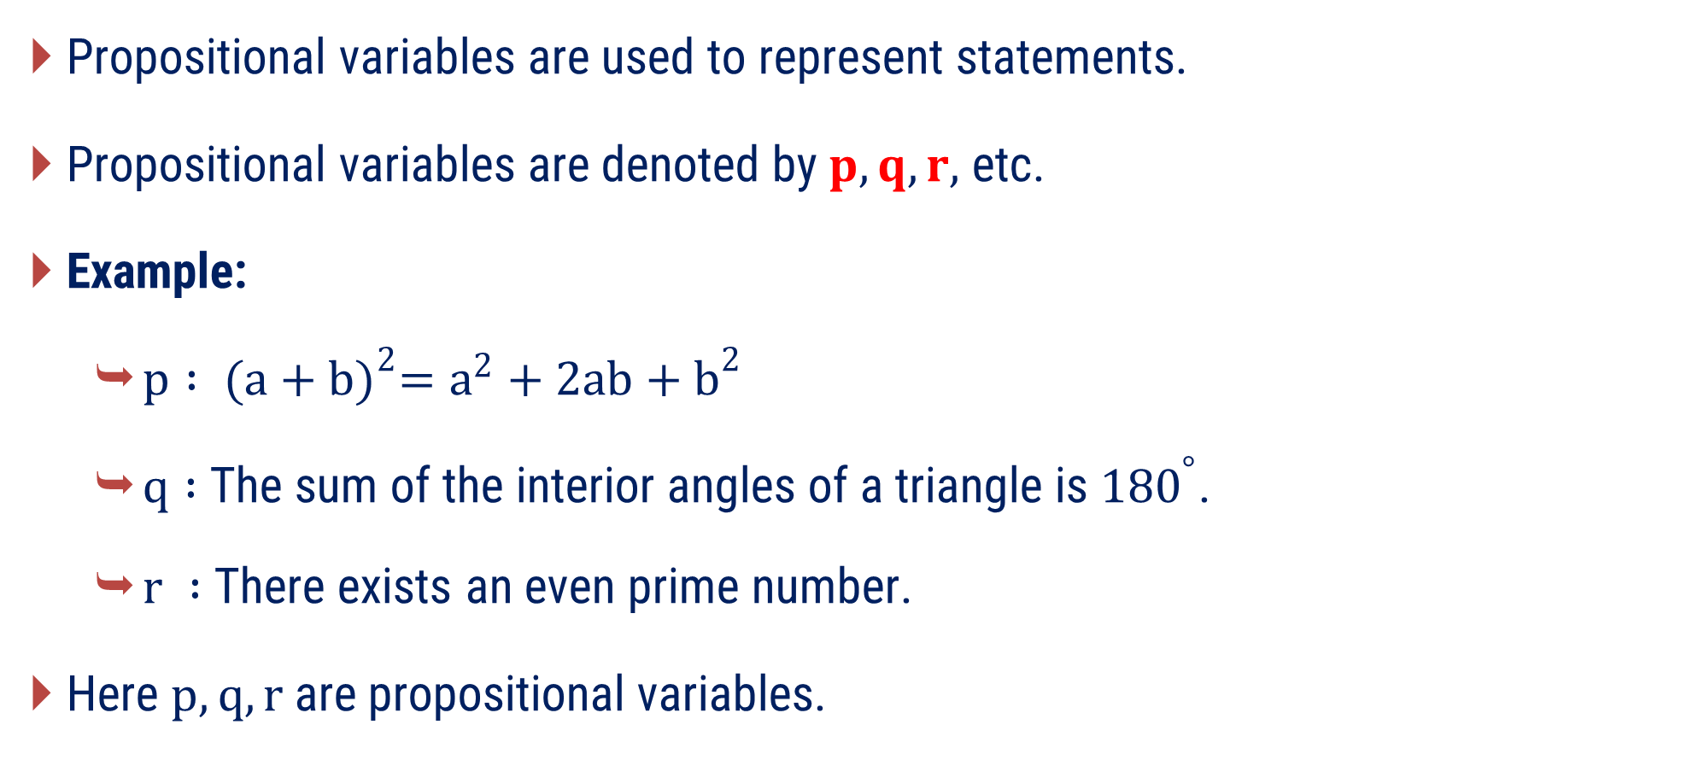
Propositional Variable
Propositional variables are used to represent statements.
Propositional variables are denoted by $p, q, r,$ etc.
Example:
$p : {(a+b)}^{2}=a^{2}+2ab+b^{2}$
$q :$The sum of the interior angles of a triangle is ${180}^{°}$.
$r :$There exists an even prime number.
Here $p, q, r$are propositional variables.

Slide 12
Types of Proposition
There are two types of propositions:
1
Simple Proposition or Atomic Proposition
2
Compound Proposition

Slide 13
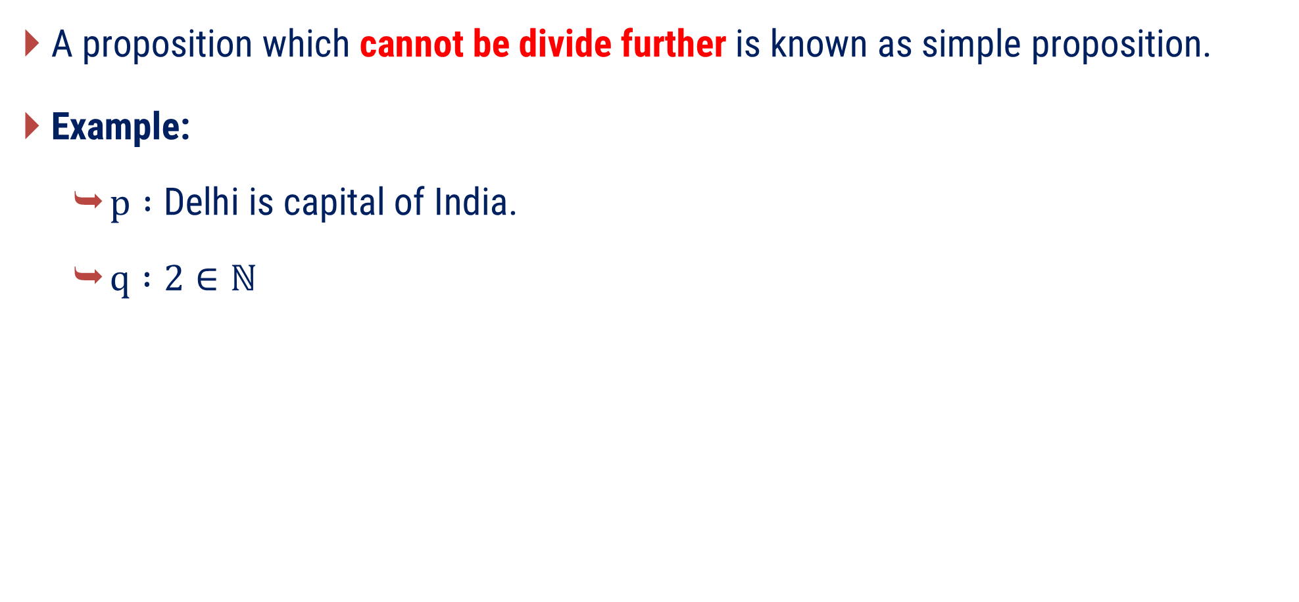
Simple Proposition (Atomic Proposition)
A proposition which cannot be divide further is known as simple proposition.
Example:
$p :\text{Delhi} \text{is} \text{capital} \text{of} \text{India}$.
$q :2∈ℕ$

Slide 14
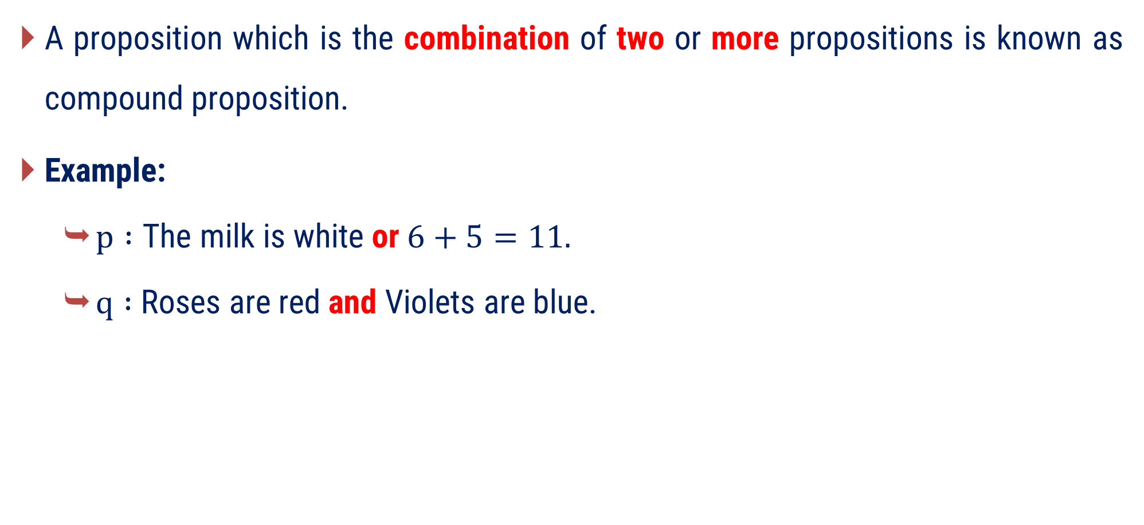
Compound Proposition
A proposition which is the combination of two or more propositions is known as compound proposition.
Example:
$p :\text{The} \text{milk} \text{is} \text{white} \text{or} 6+5=11.$
$q :$Roses are red and Violets are blue.

Slide 15
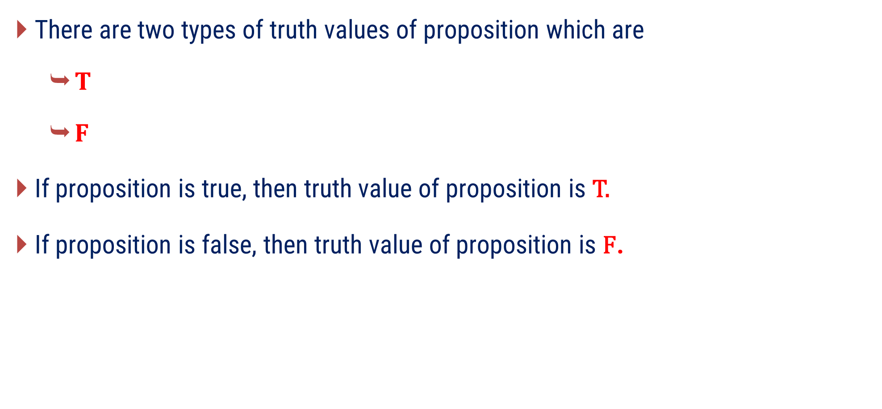
Truth Values of Proposition
There are two types of truth values of proposition which are
$T$
$F$
If proposition is true, then truth value of proposition is T.
If proposition is false, then truth value of proposition is F.

Slide 16



Truth Values of Proposition (Cont’d)
Example:
Sentence
True / False / None
Truth Value
$$p : 9>13$$
False
$$F$$
$q :$ Drink it quickly.
None
No Truth Value

Slide 17
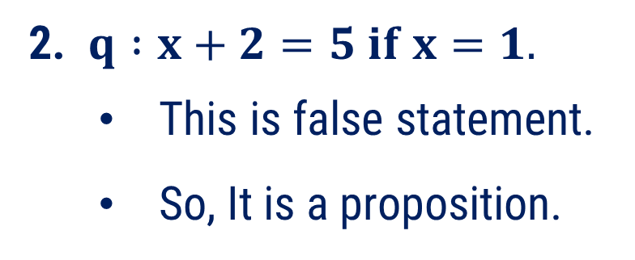
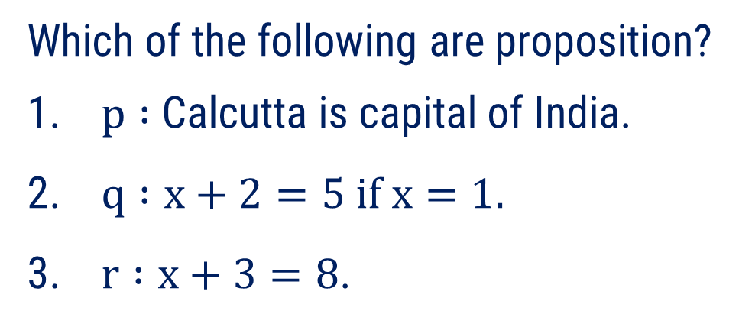
Method 1 ⇝ Example 1
Question
Which of the following are proposition?
$p :$Calcutta is capital of India.
$q :x+2=5 if x=1.$
$r :x+3=8$.
Solution
1. p : Calcutta is capital of India.
This is false statement.
So, It is a proposition.
2. $q :x+2=5 if x=1.$
This is false statement.
So, It is a proposition.

Slide 18
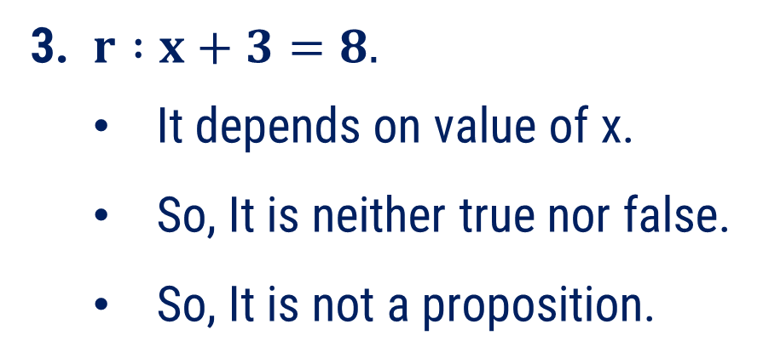
Method 1 ⇝ Example 1(Cont’d)
Question
Which of the following are proposition?
$p :$Calcutta is capital of India.
$q :x+2=5 if x=1.$
$r :x+3=8$.
Solution
3. $r :x+3=8.$
It depends on value of x.
So, It is neither true nor false.
So, It is not a proposition.

Slide 19
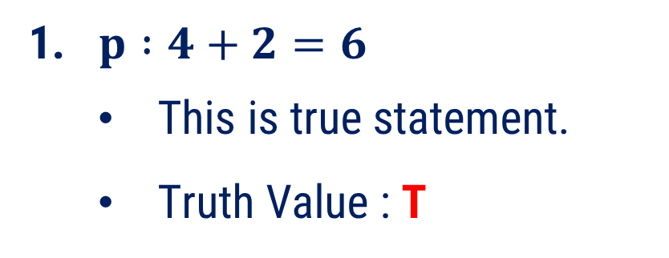
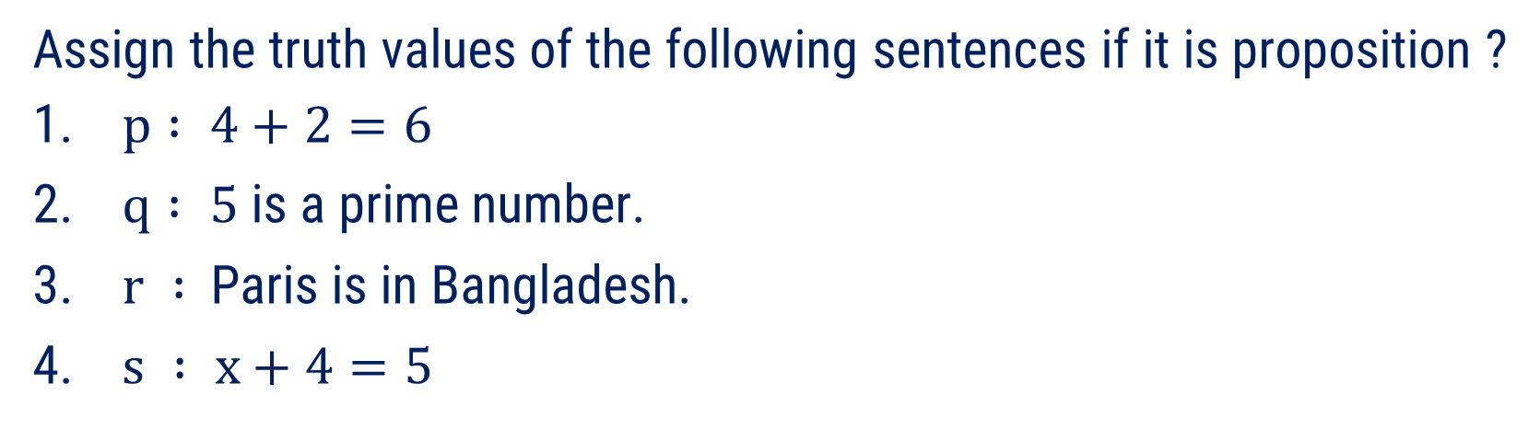
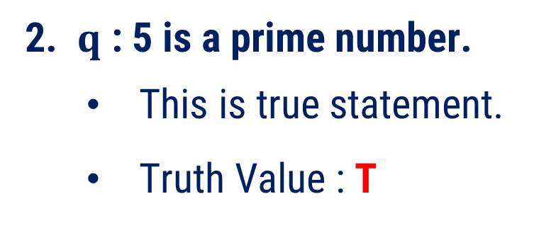
Method 1 ⇝ Example 2
Question
Assign the truth values of the following sentences if it is proposition ?
$p : 4+2=6$
$q : 5$is a prime number.
$r :$Paris is in Bangladesh.
$s : x+4=5$
Solution
1. $p :4+2=6$
This is true statement.
Truth Value : T
2. $q$ : 5 is a prime number.
This is true statement.
Truth Value : T

Slide 20
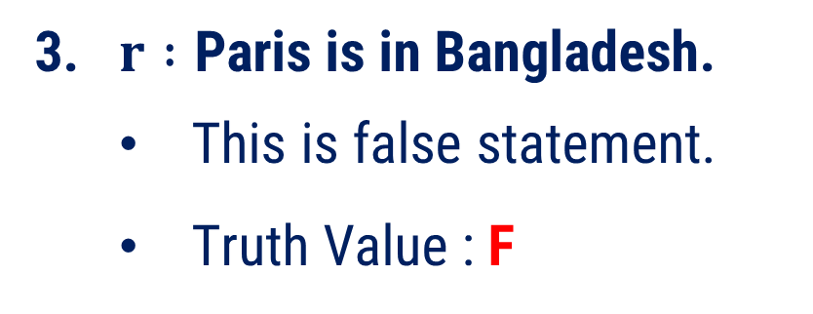
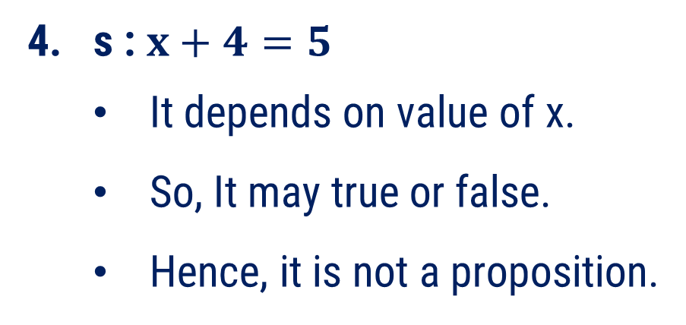
Method 1 ⇝ Example 2(Cont’d)
Question
Assign the truth values of the following sentences if it is proposition ?
$p : 4+2=6$
$q : 5$is a prime number.
$r :$Paris is in Bangladesh.
$s : x+4=5$
Solution
3. $r :\text{Paris} \text{is} \text{in} \text{Bangladesh}\text{.}$
This is false statement.
Truth Value : F
4. s : $x+4=5$
It depends on value of x.
So, It may true or false.
Hence, it is not a proposition.

Slide 21
Method 2
Logical Connectives

Slide 22
Logical Connectives
Logical connectives are also known as logical operators.
They are used to connect two or more propositions.
There are five types of logical connectives which are
1
Conjunction
4
Conditional
2
Disjunction
5
Biconditional
3
Negation

Slide 23
Method 2.1
Conjunction

Slide 24
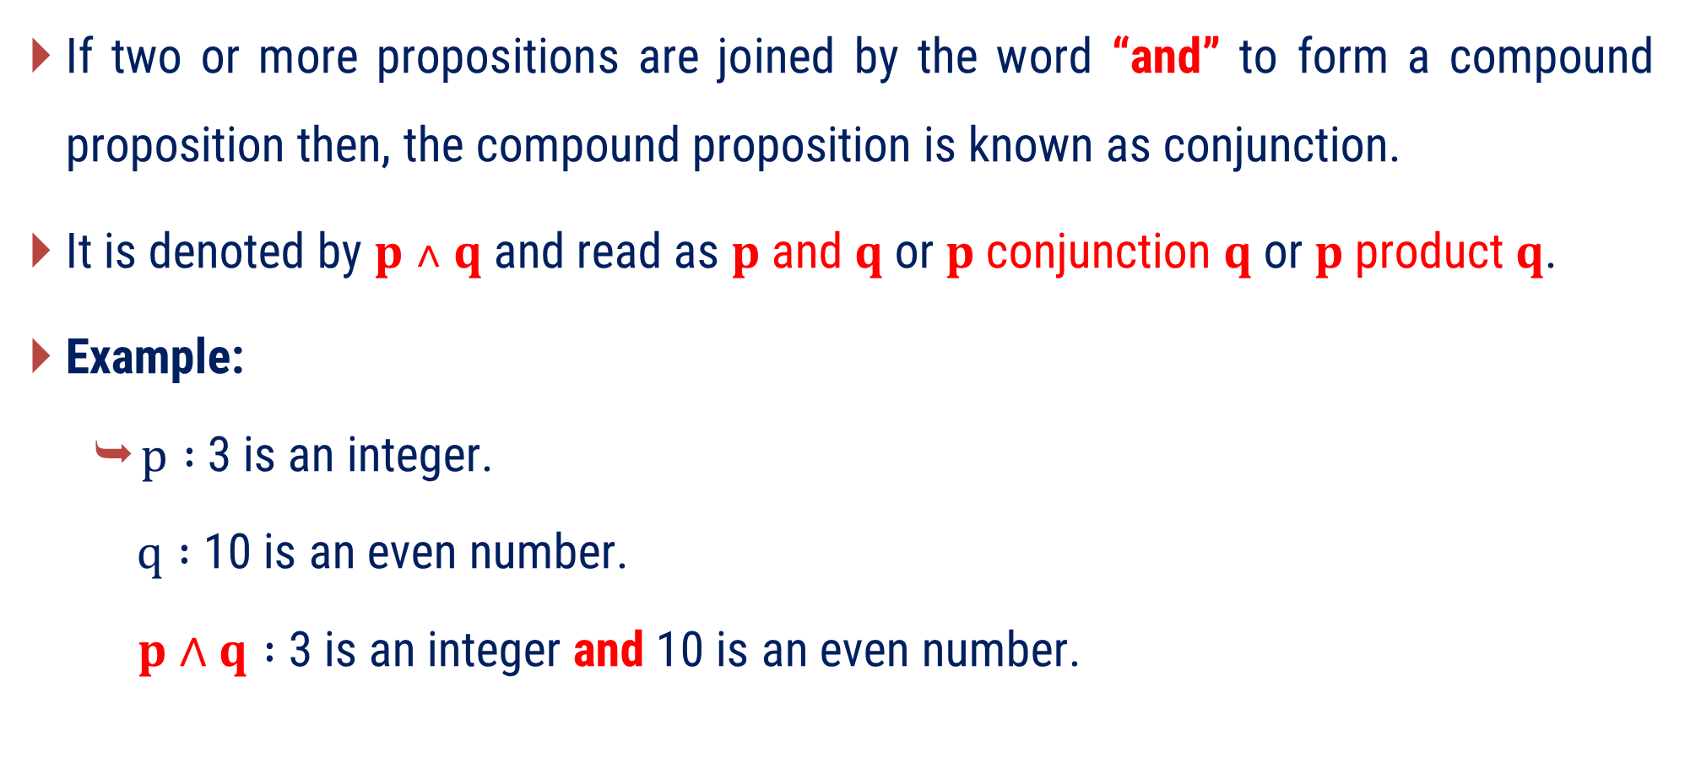
Conjunction
If two or more propositions are joined by the word “and” to form a compound proposition then, the compound proposition is known as conjunction.
It is denoted by $p ˄ q$ and read as $p$and$q$or$p$conjunction $q$or$p$product $q$.
Example:
$p :$3 is an integer.
$q :$ 10 is an even number.
$p∧q :$ 3 is an integer and 10 is an even number.

Slide 25
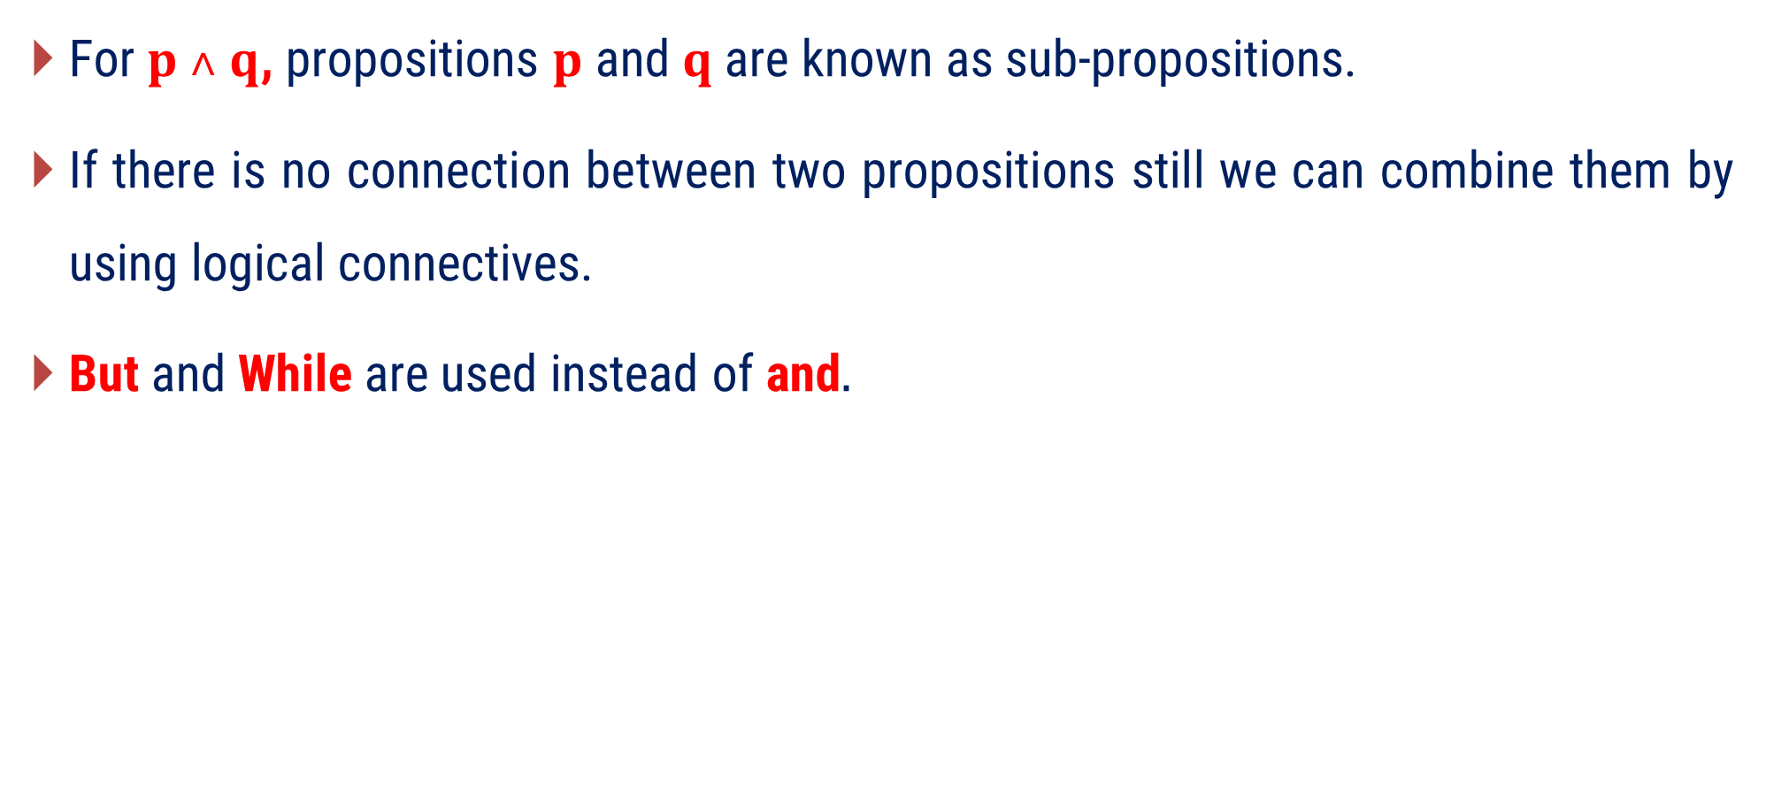
Conjunction (Cont’d)
For$p ˄ q$, propositions $p$ and $q$ are known as sub-propositions.
If there is no connection between two propositions still we can combine them by using logical connectives.
But and While are used instead of and$.$

Slide 26













Conjunction (Cont’d)
Truth values of $p ˄ q$ and $q ˄ p$ are same.
Truth Table of Conjunction
$$p$$
$$q$$
$$p ∧ q$$
$$T$$
$$T$$
$$T$$
$$T$$
$$F$$
$$F$$
$$F$$
$$T$$
$$F$$
$$F$$
$$F$$
$$F$$

Slide 27
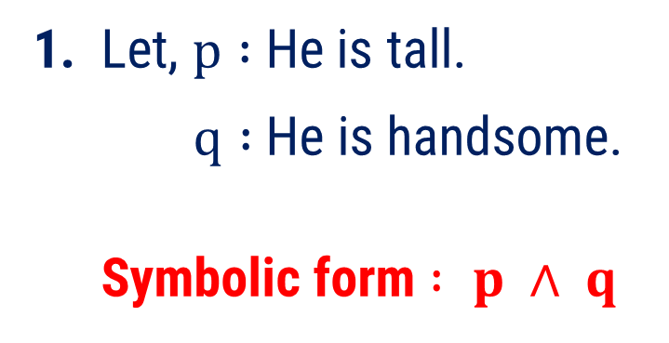
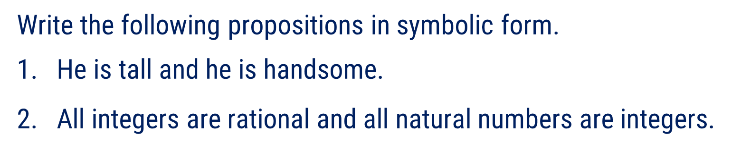
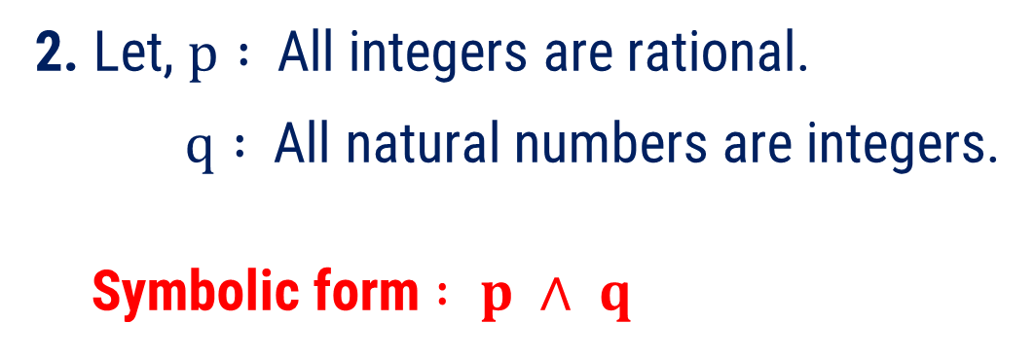
Method 2.1 ⇝ Example 1
Question
Write the following propositions in symbolic form.
$\text{He} \text{is} \text{tall} \text{and} \text{he} \text{is} \text{handsome}\text{.}$
All integers are rational and all natural numbers are integers.
Solution
1. Let, $p :$He is tall.
$q :$He is handsome.
Symbolic form $: p ∧ q$
2. Let, $p :$All integers are rational.
$q :$All natural numbers are integers.
Symbolic form $: p ∧ q$

Slide 28



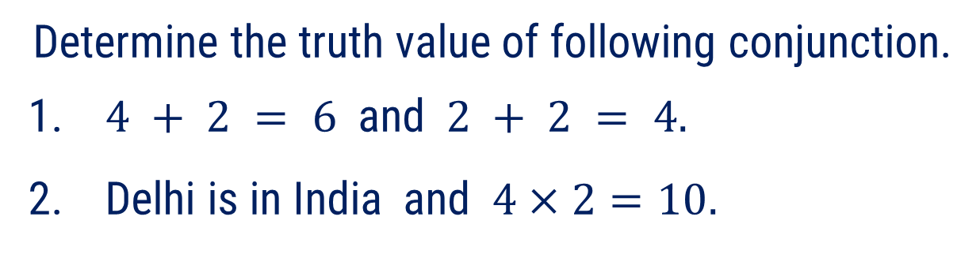



Method 2.1 ⇝ Example 2
Question
Determine the truth value of following conjunction.
$4 + 2 = 6 \text{and} 2 + 2 = 4.$
Delhi is in India and $4×2=10.$
Solution(1)
Statement
Truth Value
$p : 4 + 2 = 6$
$$T$$
$q :2 + 2 =4$
$$T$$
$p∧q : 4 + 2 = 6$ and $2 + 2 =4$
$$T∧T=T$$

Slide 29






Method 2.1 ⇝ Example 2
Question
Determine the truth value of following conjunction.
$4 + 2 = 6 \text{and} 2 + 2 = 4.$
Delhi is in India and $4×2=10.$
Solution(2)
Statement
Truth Value
$p :\text{Delhi} \text{is} \text{in} \text{India}$.
$$T$$
$$q :4×2=10$$
$$F$$
$p∧q :\text{Delhi} \text{is} \text{in} \text{India}$ and $4×2=10$.
$$T∧F=F$$

Slide 30









Method 2.1 ⇝ Example 3
Question
Construct truth table for $\left( p ˄ q \right) ˄ r.$
Solution
$$p$$ | $$q$$ | $$r$$ | $$\left( p ˄ q \right) ˄ r$$
$$T$$
$$T$$ | $$T$$ | $$T$$
$$F$$
$$T$$ | $$T$$ | $$F$$
$$F$$
$$T$$ | $$F$$ | $$T$$
$$F$$
$$T$$ | $$F$$ | $$F$$
$$F$$ | $$T$$ | $$T$$
$$F$$
$$F$$ | $$T$$ | $$F$$
$$F$$
$$F$$ | $$F$$ | $$T$$
$$F$$
$$F$$ | $$F$$ | $$F$$
$$F$$

Slide 31
Method 2.2
Disjunction

Slide 32
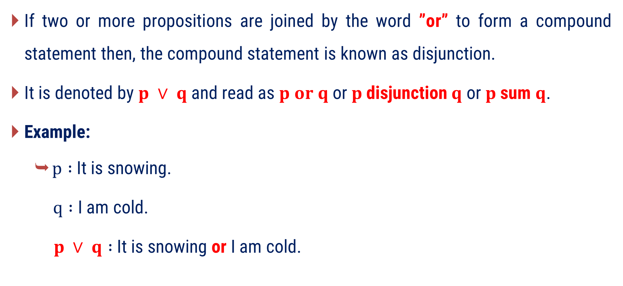
Disjunction
If two or more propositions are joined by the word ”or” to form a compound statement then, the compound statement is known as disjunction.
It is denoted by $p ∨ q$ and read as $p or q$ or $p$disjunction $q$ or $p$sum $q$.
Example:
$p :$It is snowing.
$q :$ I am cold.
$p ∨ q :$It is snowing or I am cold.

Slide 33
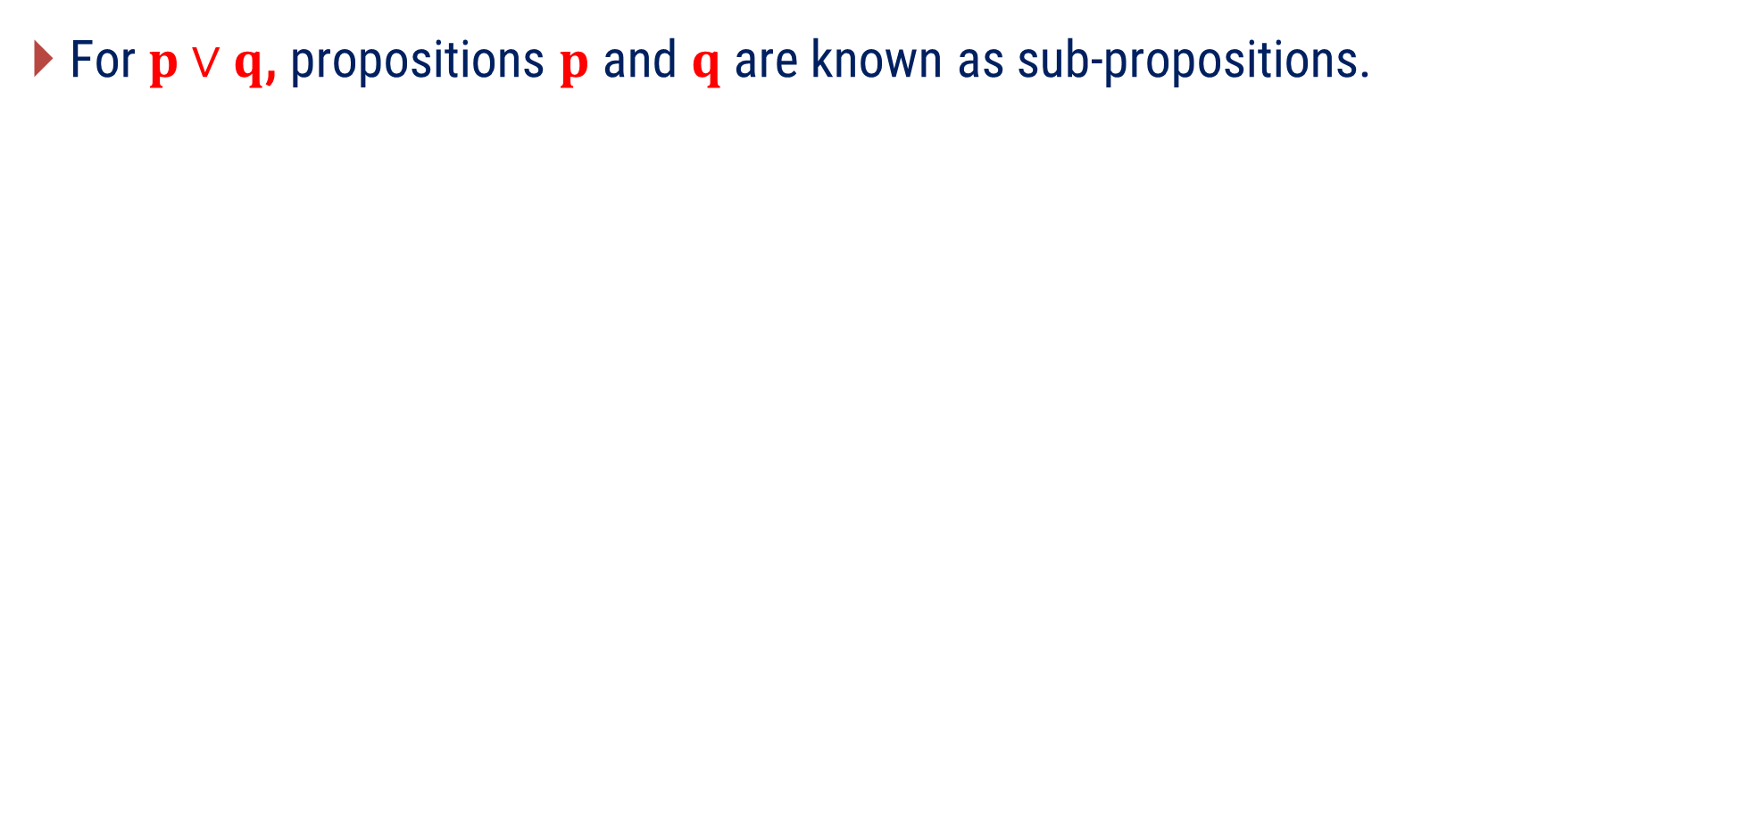
Disjunction (Cont’d)
For$p∨q$, propositions $p$ and $q$ are known as sub-propositions.

Slide 34



Disjunction (Cont’d)
Truth values of $p∨q$ and $q∨p$ are same.
Truth Table of Disjunction
$$p$$
$$q$$
$$p∨q$$
$$T$$
$$T$$
$$T$$
$$T$$
$$F$$
$$T$$
$$F$$
$$T$$
$$T$$
$$F$$
$$F$$
$$F$$

Slide 35
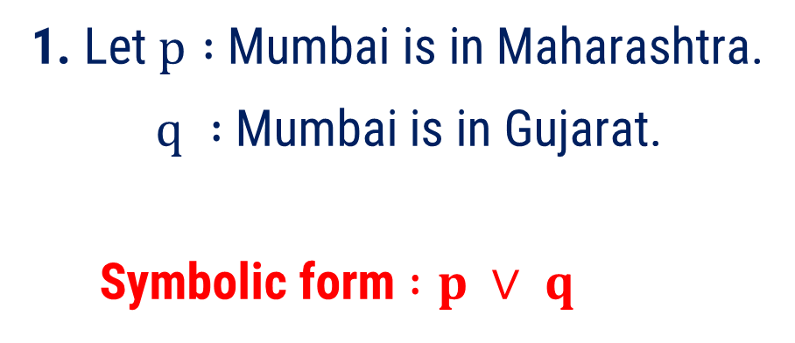
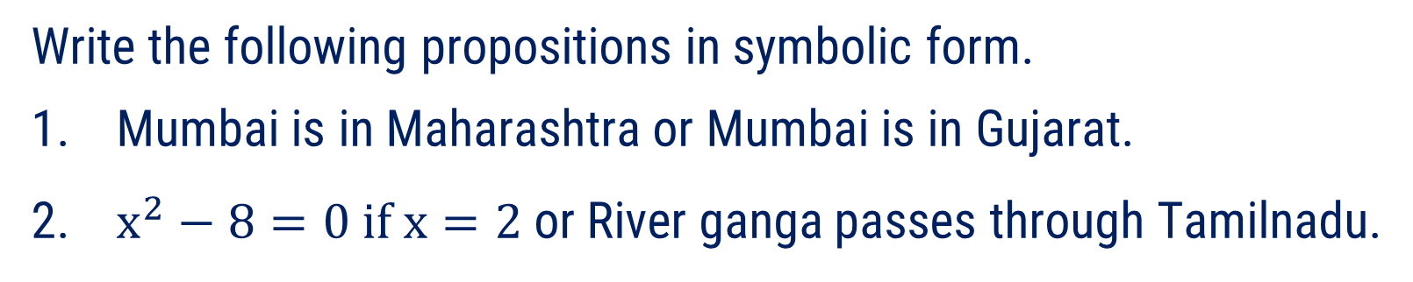
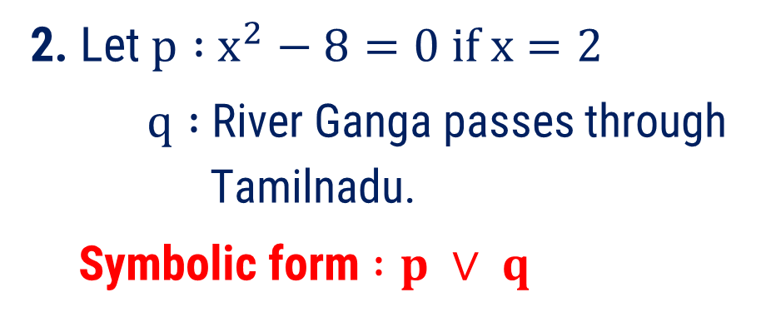
Method 2.2 ⇝ Example 1
Question
Write the following propositions in symbolic form.
Mumbai is in Maharashtra or Mumbai is in Gujarat.
$x^{2}−8=0 if x=2$or River ganga passes through Tamilnadu.
Solution
1. Let $p :$Mumbai is in Maharashtra.
$q :$Mumbai is in Gujarat.
Symbolic form $:p ∨ q$
2. Let $p :$ $x^{2}−8=0 if x=2$
$q :$River Ganga passes through
Tamilnadu.
Symbolic form $:p ∨ q$

Slide 36



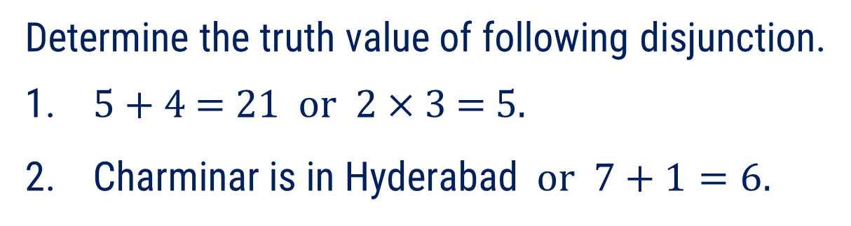


Method 2.1 ⇝ Example 2
Question
Determine the truth value of following disjunction.
$\text{5 + 4 = 21 }\text{or}\text{ 2 × 3 = 5.}$
Charminar is in Hyderabad $or 7+1=6.$
Solution(1)
Statement
Truth Value
$p :5 + 4 =21$
$$F$$
$q :2 × 3 =5$
$$F$$
$$p∨q :\text{5 + 4 = 21 } \text{or} \text{ 2 × 3 = 5.}$$
$$F∨F=F$$

Slide 37



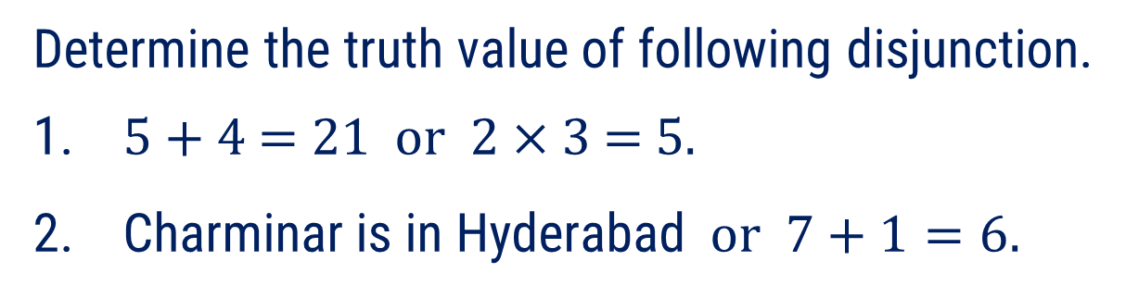

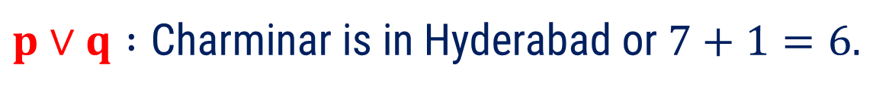

Method 2.1 ⇝ Example 2
Question
Determine the truth value of following disjunction.
$\text{5 + 4 = 21 }\text{or}\text{ 2 × 3 = 5.}$
Charminar is in Hyderabad $or 7+1=6.$
Solution(2)
Statement
Truth Value
$p :$ Charminar is in Hyderabad.
$$T$$
$$q :7+1=6$$
$$F$$
$p∨q :\text{Charminar} \text{is} \text{in} \text{Hyderabad}$ or $7+1=6.$
$$T∨F=T$$

Slide 38







Method 2.2 ⇝ Example 3
Question
Construct truth table for $\left( p ∨ q \right)∨r.$
Solution
$$p$$ | $$q$$ | $$r$$ | $$\left( p ∨ q \right) ∨ r$$
$$T$$
$$T$$ | $$T$$ | $$T$$
$$T$$
$$T$$ | $$T$$ | $$F$$
$$T$$
$$T$$ | $$F$$ | $$T$$
$$T$$
$$T$$ | $$F$$ | $$F$$
$$F$$ | $$T$$ | $$T$$
$$T$$
$$F$$ | $$T$$ | $$F$$
$$T$$
$$F$$ | $$F$$ | $$T$$
$$T$$
$$F$$ | $$F$$ | $$F$$
$$F$$

Slide 39
Method 2.3
Negation

Slide 40
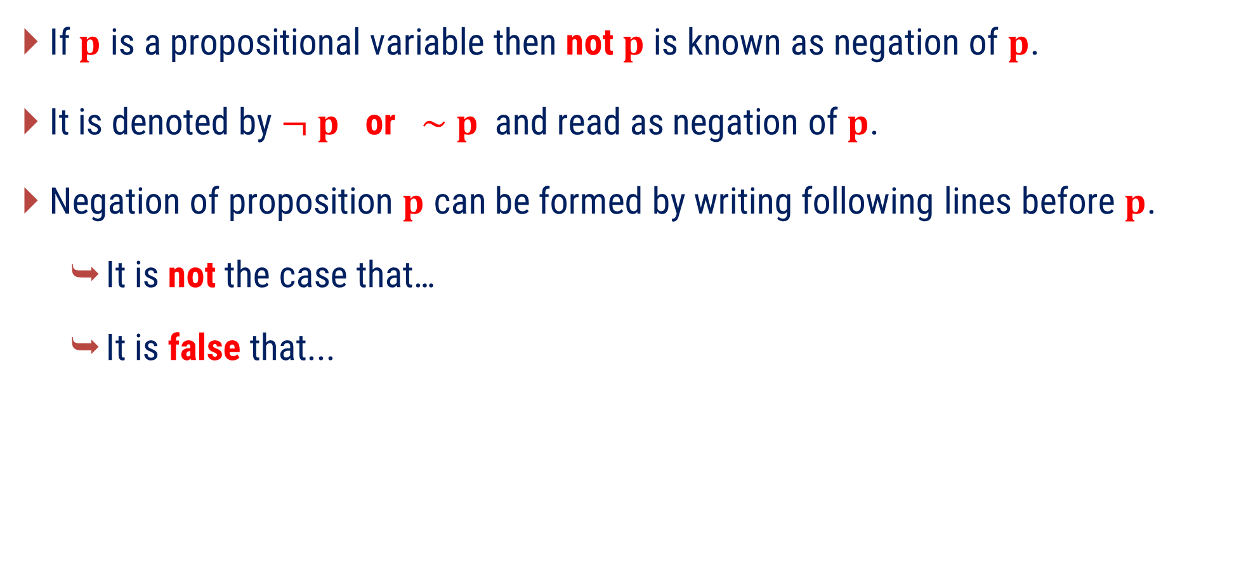
Negation
If $p$ is a propositional variable then not $p$ is known as negation of $p$.
It is denoted by $¬ p \text{or} \sim p$ and read as negation of $p$.
Negation of proposition $p$ can be formed by writing following lines before $p$.
It is not the case that…
It is false that...

Slide 41
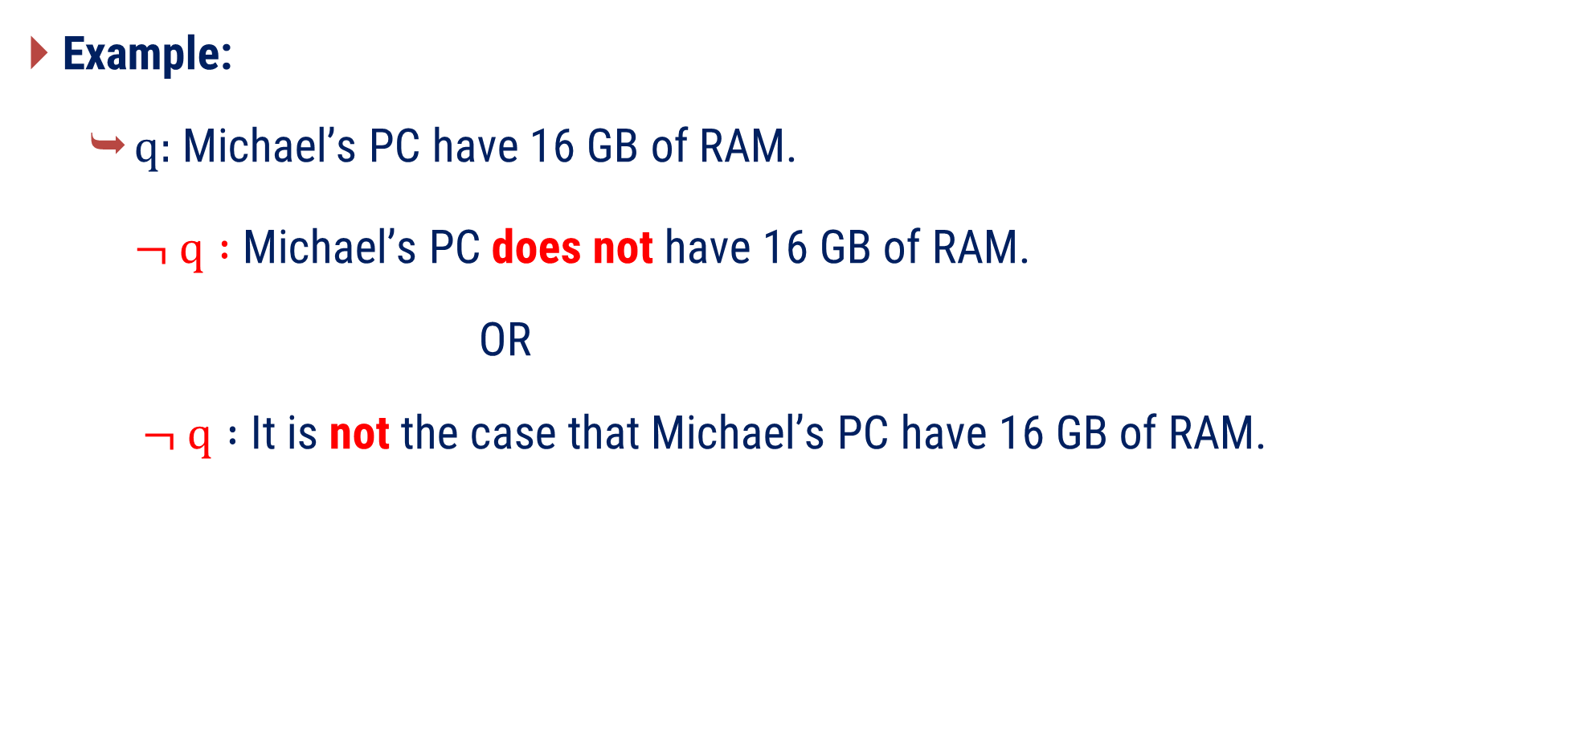
Negation (Cont’d)
Example:
$q:$Michael’s PC have 16 GB of RAM.
$¬ q :$Michael’s PC does not have 16 GB of RAM.
OR
$¬ q :$ It is not the case that Michael’s PC have 16 GB of RAM.

Slide 42






Negation (Cont’d)
Truth Table of Negation
$$p$$
$$¬ p$$
$$T$$
$$F$$
$$F$$
$$T$$

Slide 43
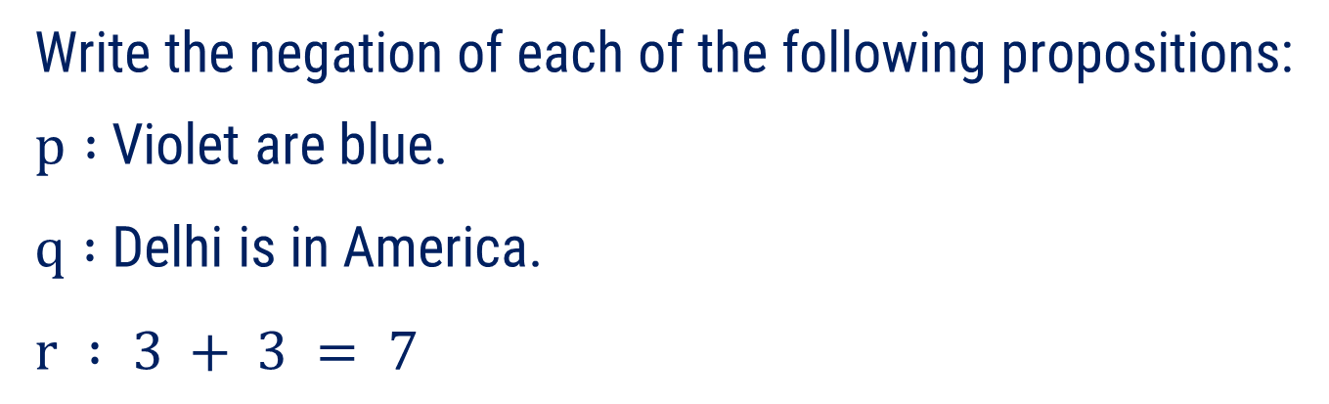

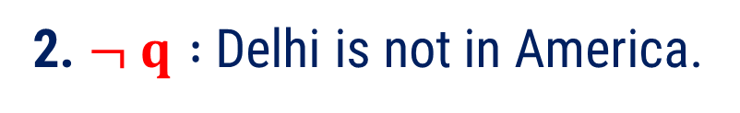

Method 2.3 ⇝ Example 1
Question
Write the negation of each of the following propositions:
$p :$Violet are blue.
$q :$Delhi is in America.
$$r : 3 + 3 = 7$$
Solution
1. $¬ p :$Violet are not blue.
2. $¬ q :$Delhi is not in America.
3. $¬ r : 3 + 3 ≠ 7$

Slide 44

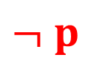
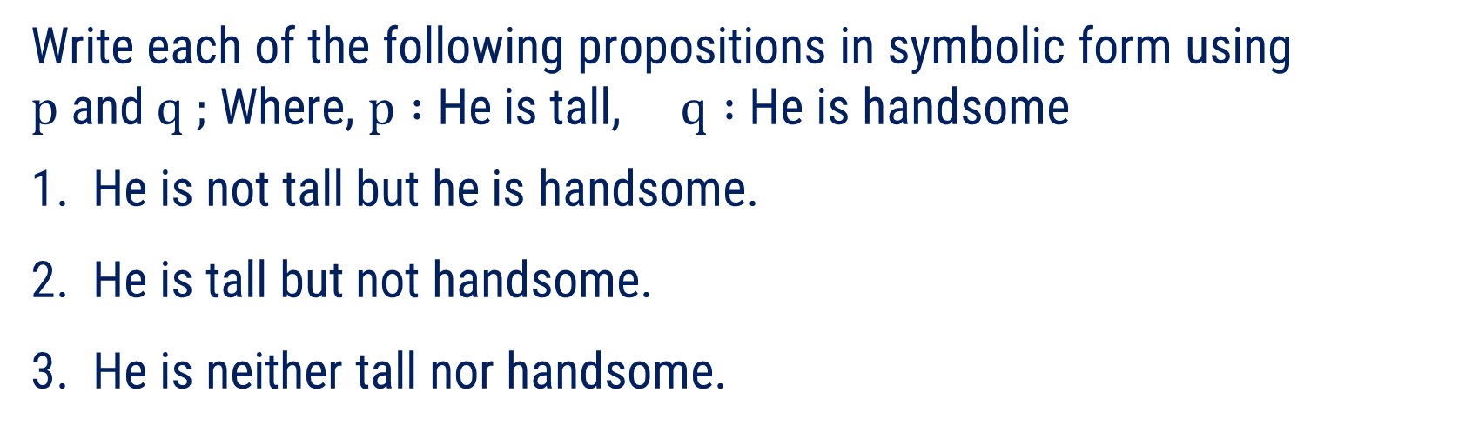
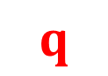


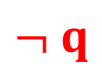
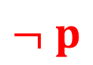





Method 2.3 ⇝ Example 2
Question
Write each of the following propositions in symbolic form using $p$ and $q ;$Where, $p :$ He is tall, $q :$He is handsome
1. He is not tall but he is handsome.
2. He is tall but not handsome.
3. He is neither tall nor handsome.
Solution
1. Symbolic form $:$
$$¬ p$$
$$∧$$
3. He is neither tall nor handsome.
i.e. He is not tall and he is not handsome.
$$q$$
2. Symbolic form $:$
$$p$$
$$∧$$
$$¬ q$$
Symbolic form $:$
$$¬ p$$
$$∧$$
$$¬ q$$

Slide 45




















Method 2.3 ⇝ Example 3
Question
Construct the truth table for compound proposition $p ˄ ¬ q$.
Solution
$$p$$
$$q$$
$$¬ q$$
$$p ˄ ¬ q$$
$$T$$
$$T$$
$$F$$
$$F$$
$$T$$
$$F$$
$$T$$
$$T$$
$$F$$
$$T$$
$$F$$
$$F$$
$$F$$
$$F$$
$$T$$
$$F$$

Slide 46






























Method 2.3 ⇝ Example 4
Question
Construct the truth table for compound proposition $\left( p ∧¬ p \right)∨¬ q$.
Solution
$$p$$
$$q$$
$$¬ p$$
$$p∧¬ p$$
$$¬ q$$
$$\left( p∧¬ p \right)∨ ¬ q$$
$$T$$
$$T$$
$$F$$
$$F$$
$$F$$
$$F$$
$$T$$
$$F$$
$$F$$
$$F$$
$$T$$
$$T$$
$$F$$
$$T$$
$$T$$
$$F$$
$$F$$
$$F$$
$$F$$
$$F$$
$$T$$
$$F$$
$$T$$
$$T$$

Slide 47
Method 2.4
Conditional

Slide 48
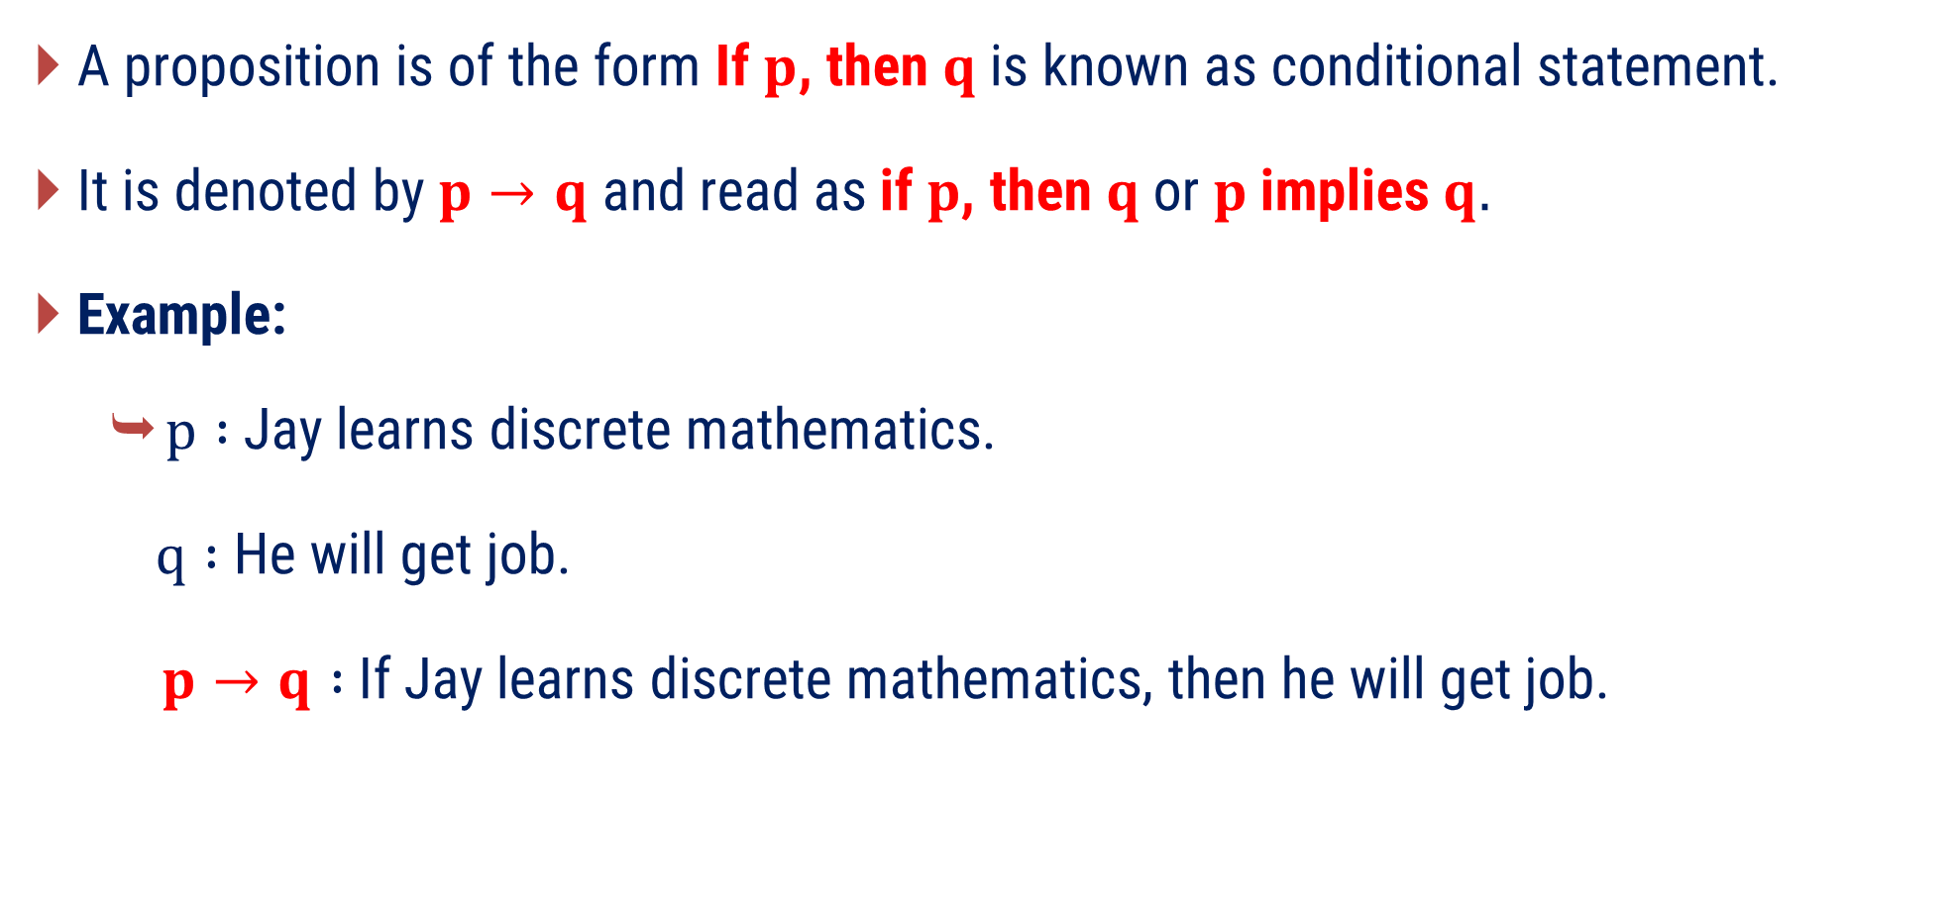
Conditional
A proposition is of the form If $p$, then $q$is known as conditional statement.
It is denoted by$p→q$ and read as$\text{if} p\text{, }\text{then} q \text{or} p \text{implies} q.$
Example:
$p :$Jay learns discrete mathematics.
$q :$ He will get job.
$p→q :$If Jay learns discrete mathematics, then he will get job.

Slide 49
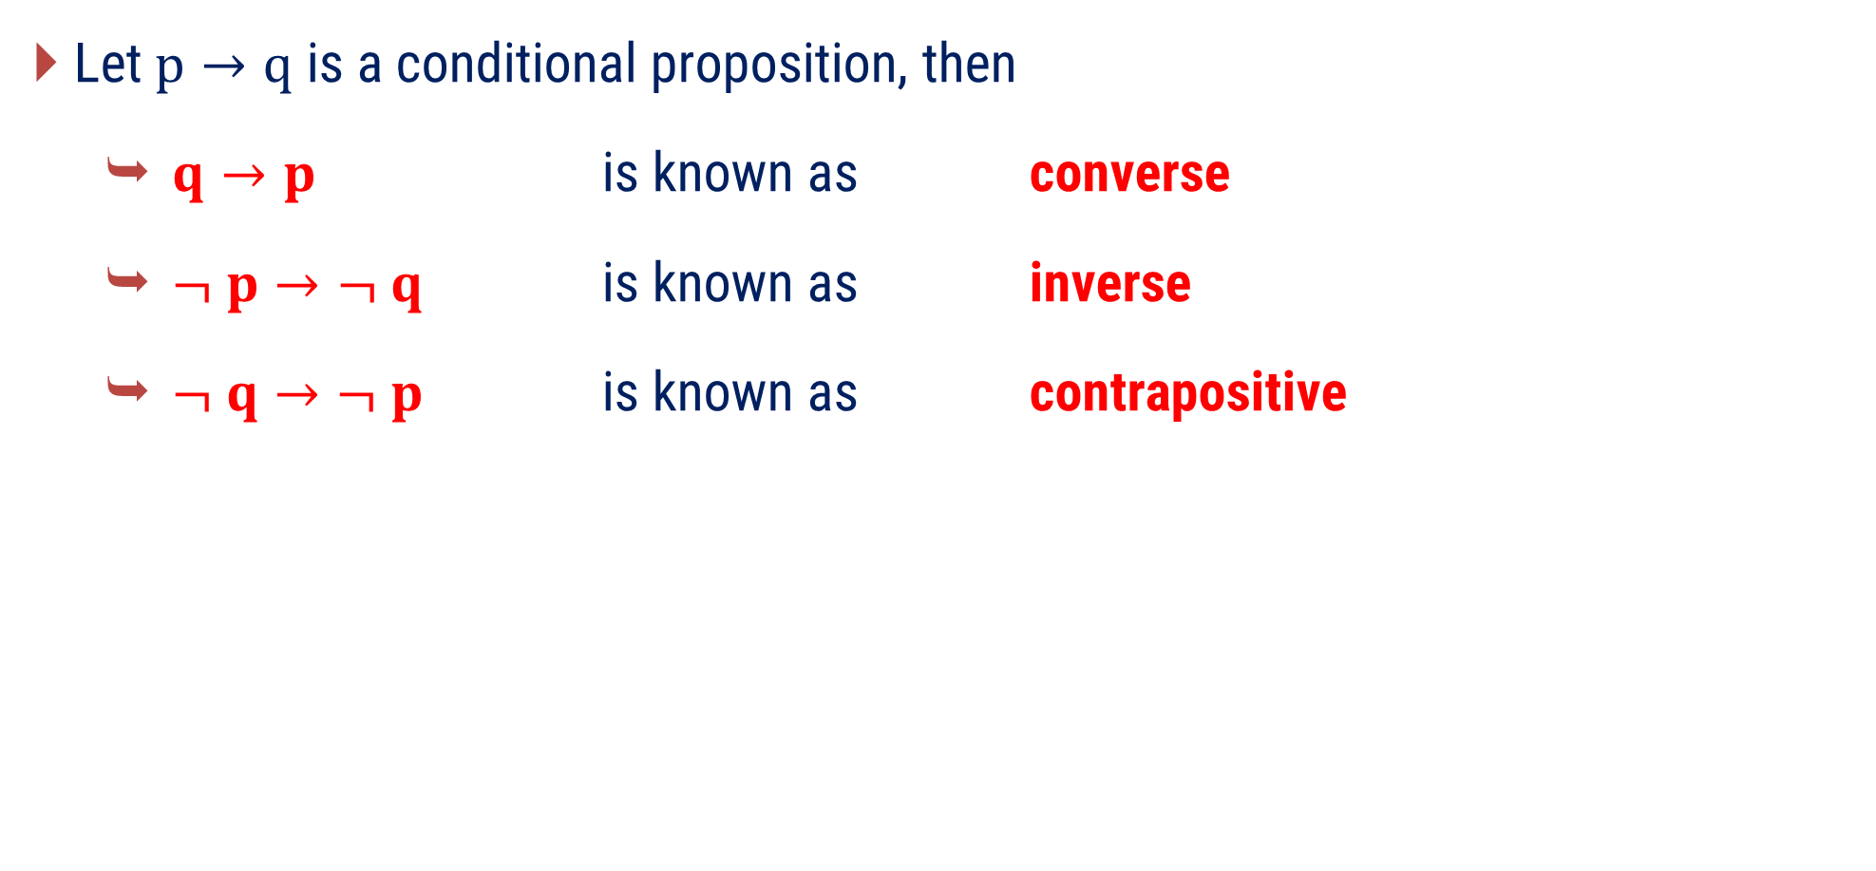
Conditional (Cont’d)
Let $p→q$ is a conditional proposition, then
$q→p$ is known as converse
$¬ p→¬ q$ is known as inverse
$¬ q→¬ p$ is known as contrapositive

Slide 50


Conditional (Cont’d)
Truth Table of Conditional
$$p$$
$$q$$
$$p→q$$
$$T$$
$$T$$
$$T$$
$$T$$
$$F$$
$$F$$
$$F$$
$$T$$
$$T$$
$$F$$
$$F$$
$$T$$

Slide 51
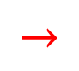


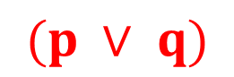


Method 2.4⇝ Example 1
Question
Express the given statement in symbolic form.
“ If Mohan takes calculus or Gopal takes English,
then Radha takes Sanskrit.”
Solution
Let, $p :$ Mohan takes calculus
Let, $q : \text{Gopal} \text{takes} \text{English}$
Let, $r : \text{Radha} \text{takes} \text{Sanskrit}$
Symbolic form :
$$(p ∨ q)$$
$$→$$
$$r$$

Slide 52
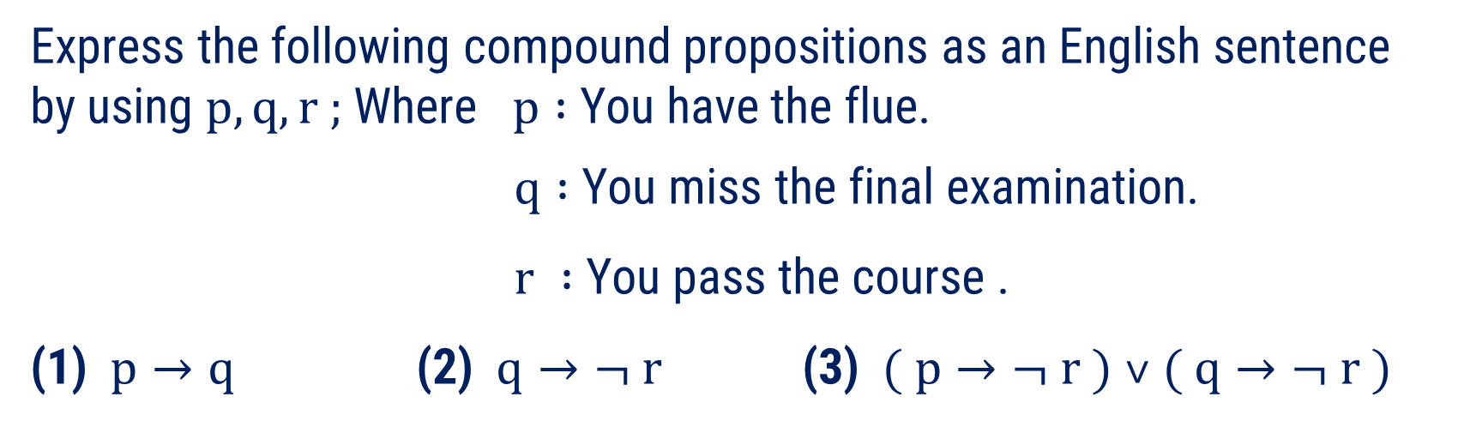

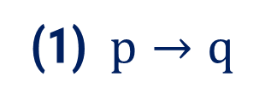
Method 2.4⇝ Example 2
Question
Express the following compound propositions as an English sentence by using $p, q, r ;$ Where $p :$You have the flue.
$q :$You miss the final examination.
$r :$You pass the course .
(1) $p→q$ (2) $q→¬ r$ (3) $( p→¬ r ) ˅ ( q→¬ r )$
Solution
(1) $p→q$
you have the flue,
Sentence form $:$
If you have the flue, then
you miss the final exam.

Slide 53

Method 2.4⇝ Example 2
Question
Express the following compound propositions as an English sentence by using $p, q, r ;$ Where $p :$You have the flue.
$q :$You miss the final examination.
$r :$You pass the course .
(1) $p→q$ (2) $q→¬ r$ (3) $( p→¬ r ) ˅ ( q→¬ r )$
Solution
(2) $q→¬ r$
you miss the final exam,
you do not pass the course.
Sentence form $:$
If you miss the final exam then

Slide 54

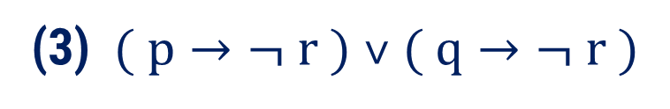
Method 2.4⇝ Example 2
Question
Express the following compound propositions as an English sentence by using $p, q, r ;$ Where $p :$You have the flue.
$q :$You miss the final examination.
$r :$You pass the course .
(1) $p→q$ (2) $q→¬ r$ (3) $( p→¬ r ) ˅ ( q→¬ r )$
Solution
(3) $( p→¬ r ) ˅ ( q→¬ r )$
you have the flue,
Sentence form $:$
If you miss the final then
you do not pass the course.
or
If you miss the final exam then
you do not pass the course.
you miss the final exam,

Slide 55

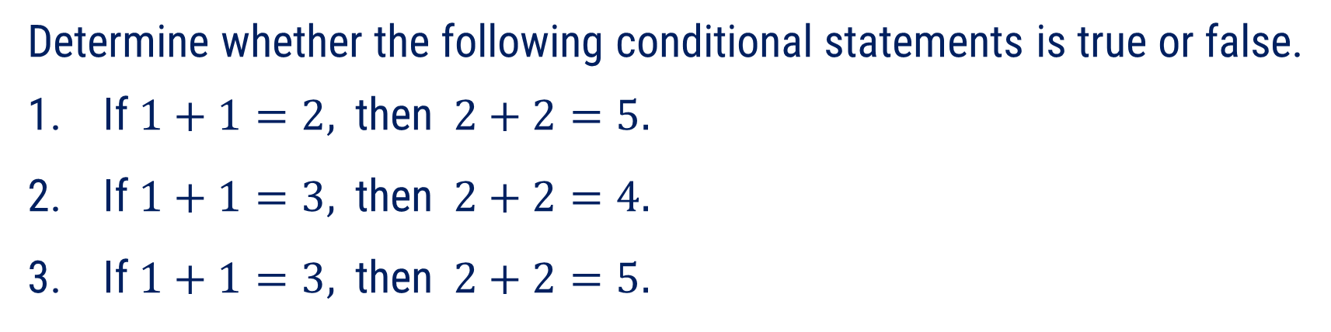

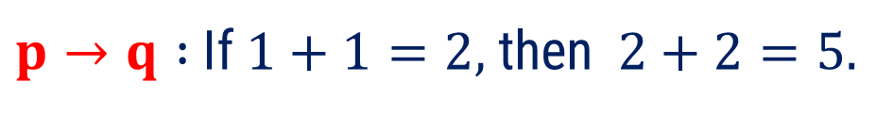
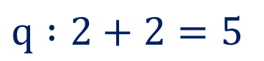


Method 2.4⇝ Example 3
Question
Determine whether the following conditional statements is true or false.
If$1+1=2,$then$2+2=5.$
If$1+1=3,$then$2+2=4.$
If$1+1=3,$then$2+2=5.$
Solution(1)
Statement
Truth Value
$$p :1+1=2$$
$$T$$
$$q :2+2=5$$
$$F$$
$p→q :$ If$1+1=2,$then$2+2=5.$
$$T→F=F$$

Slide 56


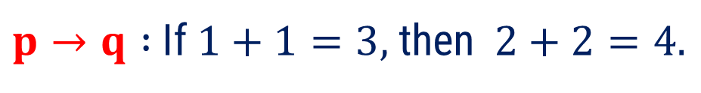
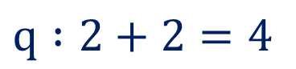


Method 2.4⇝ Example 3
Question
Determine whether the following conditional statements is true or false.
If$1+1=2,$then$2+2=5.$
If$1+1=3,$then$2+2=4.$
If$1+1=3,$then$2+2=5.$
Solution(2)
Statement
Truth Value
$$p :1+1=3$$
$$F$$
$$q :2+2=4$$
$$T$$
$p→q :$ If$1+1=3,$then$2+2=4.$
$$F→T=T$$

Slide 57

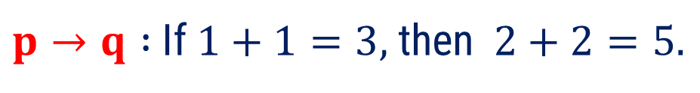
Method 2.4⇝ Example 3
Question
Determine whether the following conditional statements is true or false.
If$1+1=2,$then$2+2=5.$
If$1+1=3,$then$2+2=4.$
If$1+1=3,$then$2+2=5.$
Solution(3)
Statement
Truth Value
$$p :1+1=3$$
$$F$$
$$q :2+2=5$$
$$F$$
$p→q :$ If$1+1=3,$then$2+2=5.$
$$F→F=T$$

Slide 58

























Method 2.4 ⇝ Example 4
Question
Construct the truth table for compound proposition $( p ˅ q )→( p ˄ q )$.
Solution
$$p$$
$$q$$
$$p ˅ q$$
$$p∧q$$
$$( p ˅ q )→( p ˄ q )$$
$$T$$
$$T$$
$$T$$
$$T$$
$$T$$
$$T$$
$$F$$
$$T$$
$$F$$
$$F$$
$$F$$
$$T$$
$$T$$
$$F$$
$$F$$
$$F$$
$$F$$
$$F$$
$$F$$
$$T$$

Slide 59










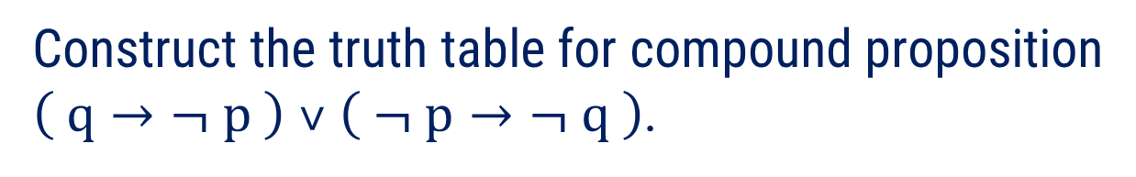

























Method 2.4 ⇝ Example 5
Question
Construct the truth table for compound proposition
$\left( q→¬ p \right) ˅ \left( ¬ p→¬ q \right)$.
Solution
$$p$$
$$q$$
$$¬ p$$
$$\left(q→¬p\right)$$
$$¬ q$$
$$\left(¬p→¬q\right)$$
$$(q→¬p)˅(¬p→¬q)$$
$$T$$
$$T$$
$$F$$
$$F$$
$$F$$
$$T$$
$$T$$
$$T$$
$$F$$
$$F$$
$$T$$
$$T$$
$$T$$
$$T$$
$$F$$
$$T$$
$$T$$
$$T$$
$$F$$
$$F$$
$$T$$
$$F$$
$$F$$
$$T$$
$$T$$
$$T$$
$$T$$
$$T$$

Slide 60
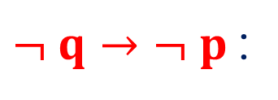









Method 2.4 ⇝ Example 6
Question
Express the converse, inverse and contrapositive statements of conditional statement given : $If x<2, then x+4<6$.
Solution
Let, $p :x<2$
$$q :x+4<6$$
Given statement can be written in symbolic form as
$p→q$.
Converse Statement
$q→p$ :
If$x+4<6,$ then$x<2$.
Inverse Statement
$¬ p→¬ q$:
If $x≮2,$ then $x+4≮6$.
Contrapositive Statement
$¬ q→¬ p$:
If $x+4≮6,$ then $x≮2$.

Slide 61
Method 2.5
Biconditional

Slide 62

Biconditional
A proposition is of the form $p$if and only if$q$is known as biconditional statement.
It is denoted by $p ⇄ q$ and read as $p$if and only if $q$.
Short form of “ if and only if ” is “ iff ”.
Example:
$p :$I am breathing.
$q :$ I am alive.
$p⇄q :$I am breathing iff I am alive.

Slide 63

Biconditional
Truth Table of Biconditional
$$p$$
$$q$$
$$p⇄q$$
$$T$$
$$T$$
$$T$$
$$T$$
$$F$$
$$F$$
$$F$$
$$T$$
$$F$$
$$F$$
$$F$$
$$T$$

Slide 64







Method 2.5⇝ Example 1
Question
Determine whether the following biconditional statements is true or false. 1. $1+1=2$ if and only if $2+2=4.$
2. $1+1=3$ if and only if $2+2=4.$
3. $1+1=3$ if and only if $2+2=5.$
Solution(1)
Statement
Truth Value
$$p :1+1=2$$
$$T$$
$$q :2+2=4$$
$$T$$
$p⇄q :1+1=2 \text{if} \text{and} \text{only} \text{if} 2+2=4$.
$$T⇄T =T$$

Slide 65




Method 2.5⇝ Example 1
Question
Determine whether the following biconditional statements is true or false. 1. $1+1=2$ if and only if $2+2=4.$
2. $1+1=3$ if and only if $2+2=4.$
3. $1+1=3$ if and only if $2+2=5.$
Solution(2)
Statement
Truth Value
$$p :1+1=3$$
$$F$$
$$q :2+2=4$$
$$T$$
$p⇄q :1+1=\text{3} \text{if} \text{and} \text{only} \text{if} 2+2=4$.
$$F⇄T =F$$

Slide 66




Method 2.5⇝ Example 1
Question
Determine whether the following biconditional statements is true or false. 1. $1+1=2$ if and only if $2+2=4.$
2. $1+1=3$ if and only if $2+2=4.$
3. $1+1=3$ if and only if $2+2=5.$
Solution(3)
Statement
Truth Value
$$p :1+1=3$$
$$F$$
$$q :2+2=5$$
$$F$$
$p⇄q :1+1=\text{3} \text{if} \text{and} \text{only} \text{if} 2+2=5$.
$$F⇄F =T$$

Slide 67

























Method 2.5 ⇝ Example 2
Question
Construct the truth table for compound proposition $\left( p ˅ q \right)⇄\left( p ˄ q \right)$.
Solution
$$p$$
$$q$$
$$p ˅ q$$
$$p∧q$$
$$( p ˅ q )⇄( p ˄ q )$$
$$T$$
$$T$$
$$T$$
$$T$$
$$T$$
$$T$$
$$F$$
$$T$$
$$F$$
$$F$$
$$F$$
$$T$$
$$T$$
$$F$$
$$F$$
$$F$$
$$F$$
$$F$$
$$F$$
$$T$$

Slide 68





































Method 2.5 ⇝ Example 3
Question
Construct the truth table for $\left( ¬ p⇄¬ q \right)⇄\left( q⇄r \right)$.
Solution
$$p$$
$$q$$
$$r$$
$$¬p$$
$$¬q$$
$$P=\left(¬p⇄¬q\right)$$
$$Q=\left(q⇄r\right)$$
$$P⇄Q$$
$$T$$
$$T$$
$$T$$
$$T$$
$$F$$
$$F$$
$$F$$
$$F$$
$$T$$
$$T$$
$$F$$
$$F$$
$$T$$
$$T$$
$$F$$
$$F$$
$$T$$
$$F$$
$$T$$
$$F$$
$$T$$
$$F$$
$$T$$
$$F$$
$$F$$
$$F$$
$$F$$
$$F$$
$$T$$
$$T$$
$$T$$
$$T$$
$$F$$
$$F$$
$$T$$
$$T$$
$$F$$
$$F$$
$$T$$
$$T$$
$$T$$
$$T$$
$$T$$
$$T$$
$$F$$
$$F$$
$$F$$
$$F$$
$$T$$
$$F$$
$$T$$
$$F$$
$$F$$
$$T$$
$$F$$
$$F$$
$$F$$
$$T$$
$$T$$
$$F$$
$$F$$
$$T$$
$$T$$
$$T$$

Slide 69
Method 3
Precedence Rule

Slide 70
Precedence Rule
Precedence rule is order of preference.
Precedence rule helps to decide which operator will get evaluated first in complicated compound propositions.

Slide 71





Precedence Rule (Cont’d)
Preference Table
Connectives | Names | Preference
$$¬$$ | Negation | 1
$$˄$$ | Conjunction | 2
$$˅$$ | Disjunction | 3
$$→$$ | Conditional | 4
$$⇄$$ | Biconditional | 5

Slide 72





Precedence Rule (Cont’d)
Example:
$p→q ˄ ¬ p$
$¬ p ˅ q ˄ r$
$p ˄ q ˅ r$
is equivalent to the expression
$$p→( q ˄ ( ¬ p ))$$
is equivalent to the expression
$$\left( ¬ p\right) ˅ ( q ˄ r )$$
is not equivalent to the expression
$$p ˄ ( q ˅ r )$$
is equivalent to the expression
$$\left( p ˄ q \right) ˅ r$$

Slide 73












Method 3 ⇝ Example 1
Question
By using Precedence rule put parenthesis at appropriate place for following compound propositions:
$p ˄ q ˅ ¬ p ˄ q$
$¬ p ˅ q ˄ r⇄p ˄ q ˅ p ˄ r$
Solution
1. $p ˄ q ˅ ¬ p ˄ q$
$$( )$$
2. $¬ p ˅ q ˄ r ⇄ p ˄ q ˅ p ˄ r$

Slide 74
Method 4
Well formed formula

Slide 75

Well-Formed Formula
Well-Formed Formula(WFF) is an expression of variables, parentheses and connective symbols.
Rules for WFF:
A propositional variable standing alone is a Well-Formed Formula i.e.,
If $p$is an propositional variable, then it is WFF.
No need to write ($p$).
If $p$ is WFF, then $¬ p$is also a WFF.

Slide 76

Well-Formed Formula (Cont’d)
Rules for WFF:
If $p$ and $q$ are WFFs, then $\left( p ˄ q \right), \left( p ˅ q \right), \left( p ↔ q \right), \left( p → q \right)$ are also WFF’s.
i.e.,
compound statement need bracket for WFF.

Slide 77

Well-Formed Formula (Cont’d)
Example:
$¬ ¬ p$
Reason: Since, $¬ p$is a WFF.
So, $¬ ¬ p$ is also a WFF.
$\left(¬ p ˄ q \right)$
Reason: $\left( ¬ p ˄ q \right)$is a compound statement and it is placed inside
parenthesis.
So, It is a WFF.

Slide 78

Well-Formed Formula (Cont’d)
Example:
$\left( p \right)$
Reason: placing $‘p’$ inside parenthesis is not considered as WFF by any rule.
$\left(\left( p→q \right)\right)$
Reason: Since, $\left( p→q \right)$ is WFF.
Suppose$, \left( p→q \right)=A$.
So, $\left(\left( p→q \right)\right)=\left(A\right),$ which is not a valid WFF.

Slide 79



Method 4 ⇝ Example 1
Question
Which of the following are well-formed formula?
$¬ \left( p ˄ q \right)$
$\left( p→q \right)→\left( ˄ q \right)$
$\left(p→\left( q→r \right)\right)$
$¬ p ˄ q→r$
$\left(\left( p→q \right) ˄ \left( q→r \right)\right)$
Solution
$¬ \left( p ˄ q \right)$
Since, $p ˄ q$ is a compound statement.
So, $\left( p ˄ q \right)$ is a WFF.
Hence, $¬\left( p ˄ q \right)$ is a WFF.

Slide 80


Method 4 ⇝ Example 1
Question
Which of the following are well-formed formula?
$¬ \left( p ˄ q \right)$
$\left( p→q \right)→\left( ˄ q \right)$
$\left(p→\left( q→r \right)\right)$
$¬ p ˄ q→r$
$\left(\left( p→q \right) ˄ \left( q→r \right)\right)$
Solution
$\left( p→q \right)→\left( ˄ q \right)$
Since, $\left(˄ q\right)$ has no meaning.
So, $\left( p→q \right)→\left( ˄ q \right)$ is not a WFF.

Slide 81


Method 4 ⇝ Example 1
Question
Which of the following are well-formed formula?
$¬ \left( p ˄ q \right)$
$\left( p→q \right)→\left( ˄ q \right)$
$\left(p→\left( q→r \right)\right)$
$¬ p ˄ q→r$
$\left(\left( p→q \right) ˄ \left( q→r \right)\right)$
Solution
$\left( p→\left( q→r \right)\right)$
Since, $\left( q→r \right)$ is a WFF.
Let, $\left( q→r \right)=t$
So, We have $\left( p→t \right)$ which is a WFF.
Hence, $\left( p→\left( q→r \right)\right)$ is a WFF.

Slide 82


Method 4 ⇝ Example 1
Question
Which of the following are well-formed formula?
$¬ \left( p ˄ q \right)$
$\left( p→q \right)→\left( ˄ q \right)$
$\left(p→\left( q→r \right)\right)$
$¬ p ˄ q→r$
$\left(\left( p→q \right) ˄ \left( q→r \right)\right)$
Solution
$¬ p ˄ q→r$
Since, There is no parenthesis given in the formula.
So, It is not a WFF.

Slide 83


Method 4 ⇝ Example 1
Question
Which of the following are well-formed formula?
$¬ \left( p ˄ q \right)$
$\left( p→q \right)→\left( ˄ q \right)$
$\left(p→\left( q→r \right)\right)$
$¬ p ˄ q→r$
$\left(\left( p→q \right) ˄ \left( q→r \right)\right)$
Solution
$\left(\left( p→q \right) ˄ \left( q→r \right)\right)$
Since, $\left( p→q \right)$and $\left( q→r \right)$ both are WFF.
Let, $\left( p→q \right)=t$ and $\left( q→r \right)=s$.
So, We have $\left( t ˄ s \right)$ which is also a WFF.
Hence, $\left(\left( p→q \right) ˄ \left( q→r \right)\right)$ a WFF.

Slide 84
Method 5
Tautologies

Slide 85









Tautology
If a compound proposition is always true for all possible truth values of its propositional variables, then compound proposition is known as tautology.
The truth table of this proposition contains only truth value $T$ in the last column
Example:
$\left( p ∨¬ p \right)$is a tautology.
$$p$$
$$¬ p$$
$\left( p ∨¬ p \right)$
$$T$$
$$F$$
$$T$$
$$F$$
$$T$$
$$T$$

Slide 86




Contradiction
If a compound proposition is always False for all possible truth values of its propositional variables, then compound proposition is known as Contradiction.
The truth table of this proposition contains only truth value F in the last column.
Example:
$\left( p ∧¬ p \right)$ is a contradiction.
$$p$$
$$¬ p$$
$$\left( p ∧¬ p \right)$$
$$T$$
$$F$$
$$F$$
$$F$$
$$T$$
$$F$$

Slide 87




Contingency
A compound proposition which is neither tautology nor contradiction is known as Contingency.
The truth table of this proposition contains T and F in the last column.
Example:
$( p→¬ p)$ is a contingency.
$$p$$
$$¬ p$$
$$\left( p→¬ p \right)$$
$$T$$
$$F$$
$$F$$
$$F$$
$$T$$
$$T$$

Slide 88
















Method 5 ⇝ Example 1
Question
Show that the following proposition is tautology:
$$\left( p→q \right)⇄\left( ¬ q→¬ p \right)$$
Solution
$$p$$
$$q$$
$$P=p→q$$
$$¬ q$$
$$¬ p$$
$$Q=¬ q→¬ p$$
$$P⇄Q$$
$$T$$
$$T$$
$$T$$
$$T$$
$$T$$
$$F$$
$$F$$
$$T$$
$$F$$
$$T$$
$$F$$
$$F$$
$$F$$
$$T$$
$$F$$
$$T$$
$$F$$
$$F$$
$$T$$
$$T$$
$$T$$
$$F$$
$$T$$
$$T$$
$$T$$
$$T$$
$$T$$
$$T$$
So, proposition $\left( p→q \right)⇄\left( ¬ q→¬ p \right)$ is tautology.

Slide 89

















Method 5 ⇝ Example 2
Question
Show that the following proposition is contradiction:
$$\left( p ˅ q \right) ˄ \left( ¬ p ˄ ¬ q \right)$$
Solution
$$p$$
$$q$$
$$P=p ˅ q$$
$$¬ p$$
$$¬ q$$
$$Q=¬ p ˄ ¬ q$$
$$P ˄ Q$$
$$T$$
$$T$$
$$T$$
$$F$$
$$F$$
$$F$$
$$T$$
$$T$$
$$F$$
$$F$$
$$T$$
$$F$$
$$T$$
$$F$$
$$F$$
$$F$$
$$F$$
$$T$$
$$T$$
$$F$$
$$T$$
$$F$$
$$T$$
$$T$$
$$F$$
$$F$$
$$F$$
$$F$$
So, proposition $\left( p ˅ q \right) ˄ \left( ¬ p ˄ ¬ q \right)$is contradiction.

Slide 90






















Method 5 ⇝ Example 3
Question
Show that the compound proposition
$\left( p→q \right) ˄ \left(\left( q→r \right)→\left( p→r \right)\right)$ is contingency.
Solution
$$P=$$
$$p→q$$
$$Q=$$
$$q→r$$
$$R=$$
$$p→r$$
$$S=$$
$$Q→R$$
$$p$$
$$q$$
$$r$$
$$P ˄ S$$
$$F$$
$$F$$
$$F$$
$$T$$
$$T$$
$$T$$
$$T$$
$$F$$
$$F$$
$$F$$
$$F$$
$$T$$
$$T$$
$$F$$
$$F$$
$$T$$
$$T$$
$$F$$
$$F$$
$$T$$
$$T$$
$$F$$
$$F$$
$$T$$
$$T$$
$$T$$
$$T$$
$$T$$
$$T$$
$$T$$
$$T$$
$$T$$
$$T$$
$$F$$
$$F$$
$$T$$
$$T$$
$$T$$
$$T$$
$$T$$
$$T$$
$$T$$
$$F$$
$$F$$
$$T$$
$$F$$
$$T$$
$$F$$
$$T$$
$$F$$
$$T$$
$$F$$
$$F$$
$$F$$
$$T$$
$$T$$
$$T$$
$$T$$
$$T$$
$$T$$
$$T$$
$$T$$
$$T$$
$$T$$
$$T$$
$$T$$

Slide 91

Method 5 ⇝ Example 3 (Cont’d)
Question
Show that the compound proposition
$\left( p→q \right) ˄ \left(\left( q→r \right)→\left( p→r \right)\right)$ is contingency.
Solution
So, the given compound proposition $\left( p→q \right) ˄ \left(\left( q→r \right)→\left( p→r \right)\right)$ is contingency.

Slide 92
Method 6
Equivalence of Formulas

Slide 93

Logical Equivalence
Let P and Q are two compound propositions.
If $P$ and $Q$have same truth values, then P and Q are known as Logically Equivalent or simply Equivalent.
It is denoted by $P ≡ Q$and read as $P$is equivalent to $Q$.

Slide 94


Laws of Logic
Idempotent Laws:
$p ˅ p ≡ p$
$p ˄ p ≡ p$
Commutative Laws:
$p ˅ q ≡ q ˅ p$
$p ˄ q ≡ q ˄ p$
Associative Laws:
$\left( p ˅ q \right) ˅ r≡p ˅ \left( q ˅ r \right)$
$\left( p ˄ q \right) ˄ r≡p ˄ \left( q ˄ r \right)$
Distributive Laws:
$p ˅ \left( q ˄ r \right)≡\left( p ˅ q \right) ˄ \left( p ˅ r \right)$
$p ˄ \left( q ˅ r \right)≡\left( p ˄ q \right) ˅ \left( p ˄ r \right)$

Slide 95


Laws of Logic
Identity Laws:
$p ˄ T ≡ p$
$p ˅ F ≡ p$
$p ˄ F ≡ F$
$p ˅ T ≡ T$
Involution Law:
$¬¬ p≡p$
Complement Laws:
$p ˅ ¬ p≡T$
$p ˄ ¬ p≡F$
$¬ T≡F$
$¬ F≡T$
De Morgan’s Laws:
$¬ \left( p ˅ q \right)≡\left( ¬ p ˄ ¬ q \right)$
$¬ \left( p ˄ q \right)≡\left( ¬ p ˅ ¬ q \right)$

Slide 96




















Method 6 ⇝ Example 1
Question
Show that the $\left( p⇄q \right)≡\left(\left( ¬ p ˄ ¬ q \right) ˅ \left( p ˄ q \right)\right)$.
Solution
$$p$$
$$q$$
$$P=p⇄q$$
$$¬ p$$
$$¬ q$$
$$R=¬ p ˄ ¬ q$$
$$S=p ˄ q$$
$$Q=R ˅ S$$
$$T$$
$$T$$
$$F$$
$$F$$
$$F$$
$$F$$
$$F$$
$$F$$
$$F$$
$$F$$
$$F$$
$$F$$
$$T$$
$$T$$
$$F$$
$$T$$
$$F$$
$$T$$
$$T$$
$$T$$
$$F$$
$$F$$
$$T$$
$$T$$
$$F$$
$$F$$
$$T$$
$$F$$
$$T$$
$$F$$
$$T$$
$$T$$
Here, P and Q have same truth values. So, $\left( p⇄q \right)≡\left(\left( ¬ p ˄ ¬ q \right) ˅ \left( p ˄ q \right)\right)$.

Slide 97















Method 6 ⇝ Example 2
Question
Check whether the compound propositions $¬ \left( p⇄q \right)$ and
$\left( p⇄¬ q \right)$ are equivalent or not?
Solution
$$p$$
$$q$$
$$p⇄q$$
$$\text{P} \text{=} ¬ \left( p⇄q \right)$$
$$¬ q$$
$$Q=p⇄¬ q$$
$$F$$
$$T$$
$$T$$
$$F$$
$$F$$
$$T$$
$$F$$
$$T$$
$$F$$
$$F$$
$$T$$
$$T$$
$$F$$
$$F$$
$$T$$
$$F$$
$$T$$
$$F$$
$$T$$
$$T$$
$$T$$
$$T$$
$$F$$
$$F$$
Here, P and Q have same truth values. So, $¬ \left( p⇄q \right)≡\left( p⇄¬ q \right).$

Slide 98





















Method 6 ⇝ Example 3
Question
Check whether the compound propositions $\left( p→\left( q ˅ r \right)\right)$ and $\left(\left( r→q \right) ˅ \left( p→r \right)\right)$ are equivalent or not?
Solution
$$P=$$
$$q ˅ r$$
$$Q=$$
$$p→P$$
$$R=$$
$$r→p$$
$$S=$$
$$p→r$$
$$T=$$
$$R ˅ S$$
$$p$$
$$q$$
$$r$$
$$F$$
$$F$$
$$T$$
$$T$$
$$T$$
$$T$$
$$T$$
$$T$$
$$T$$
$$T$$
$$T$$
$$T$$
$$T$$
$$T$$
$$T$$
$$T$$
$$T$$
$$T$$
$$F$$
$$F$$
$$F$$
$$F$$
$$T$$
$$T$$
$$F$$
$$F$$
$$T$$
$$T$$
$$F$$
$$F$$
$$T$$
$$T$$
$$T$$
$$T$$
$$T$$
$$T$$
$$F$$
$$F$$
$$F$$
$$F$$
$$F$$
$$T$$
$$F$$
$$T$$
$$F$$
$$T$$
$$F$$
$$T$$
$$F$$
$$T$$
$$T$$
$$T$$
$$T$$
$$T$$
$$T$$
$$T$$
$$T$$
$$T$$
$$T$$
$$T$$
$$T$$
$$T$$
$$T$$
$$T$$

Slide 99

Method 6 ⇝ Example 3 (Cont’d)
Question
Check whether the compound propositions $\left( p→\left( q ˅ r \right)\right)$ and $\left(\left( r→q \right) ˅ \left( p→r \right)\right)$ are equivalent or not?
Solution
Here, Q and T have different truth values.
So, $\left( p→\left( q ˅ r \right)\right)≢\left(\left( r→q \right) ˅ \left( p→r \right)\right).$

Slide 100
Method 7
Normal Forms

Slide 101
Normal forms
In propositional logic if there are many variables, then construction of truth table becomes complicated. So, it is required to convert it in easier form which is known as Normal Forms.
It is also known as Canonical Forms.
There are four types of normal forms which are
Disjunctive Normal Form (DNF)
Conjunctive Normal Form (CNF)
Principle Disjunctive Normal Form (PDNF)
Principle Conjunctive Normal Form (PCNF)

Slide 102

Elementary Sum
A sum(disjunction) of the variables and their negations is known as Elementary Sum.
It is also known as Fundamental Disjunction.
Example:
$p ˅ ¬ p$
$¬ p ˅ p ˅ ¬ q$

Slide 103

Elementary Product
A product(conjunction) of the variables and their negations is known as Elementary Product.
It is also known as Fundamental Conjunction.
Example:
$p ˄ ¬ p$
$¬ p ˄ p ˄ ¬ q$

Slide 104

Minterm
Let p and q be two statement variables, then $p ˄ q, p ˄ ¬ q, ¬ p ˄ q$ and $¬ p ˄ ¬ q$ are known as Minterms of p and q.
Note that none of the minterms should contain both a variable and its negation.
$p ˄ ¬ p$ is not minterm.
The number of minterms in $n$ variables is $2^{n}$.

Slide 105


Minterm
Let p, q and r be three statement variables. Minterms for three variables are as below.
$p ˄ q ˄ r$
$¬ p ˄ q ˄ r$
$p ˄¬ q ˄ r$
$p ˄ q ˄ ¬ r$
$¬ p ˄ ¬ q ˄ r$
$¬ p ˄ q ˄ ¬ r$
$p ˄ ¬ q ˄ ¬ r$
$¬ p ˄ ¬ q ˄ ¬ r$

Slide 106

Maxterm
Let p and q be two statement variables, then $p ˅ q, p ˅ ¬ q, ¬ p ˅ q$ and $¬ p ˅ ¬ q$ are known as Maxterms of p and q.
It may be noted that none of the maxterms should contain both a variable and its negation.
$p ˅ ¬ p$ is not maxterm.
The number of maxterms in $n$ variables is $2^{n}$.

Slide 107


Maxterm
Let p, q and r be three statement variables. Maxterms for three variables are as below.
$p ˅ q ˅ r$
$¬ p ˅ q ˅ r$
$p ˅ ¬ q ˅ r$
$p ˅ q ˅ ¬ r$
$¬ p ˅ ¬ q ˅ r$
$¬ p ˅ q ˅ ¬ r$
$p ˅ ¬ q ˅ ¬ r$
$¬ p ˅ ¬ q ˅ ¬ r$

Slide 108
Method 7.1
Disjunctive Normal Forms

Slide 109

Disjunctive Normal Form (DNF)
If a logical expression is sum of elementary product then it is known as Disjunctive Normal Form.
Example:
$\left( p ˄ q \right) ˅ \left( p ˄ ¬ q \right)$ is a DNF.
$\left(¬ p ˄ q \right) ˅ \left(¬ p ˅ ¬ q \right)$ is not a DNF.
DNF of a given logical expression is not unique but it is equivalent to given logical expression.

Slide 110










Disjunctive Normal Form (Cont’d)
Example:
$p ˅ \left( q ˄ r \right)$ is already a DNF. But we can write it as below:
$p ˅ \left( q ˄ r \right)$
$$≡\left( p ˅ q \right) ˄ \left( p ˅ r \right)$$
$$≡\left( p ˄ p \right)$$
$$˅$$
$$\left( p ˄ r \right)$$
$$˅$$
$$\left( q ˄ p \right)$$
$$˅$$
$$\left( q ˄ r \right)$$
$,$which is also a DNF.

Slide 111

Disjunctive Normal Form (Cont’d)
Procedure to construct DNF:
Replace $" → , ⇄ "$ by using logical connectives$"¬ , ˅ , ˄” .$
Use De Morgan’s laws to eliminate $" ¬ "$ before sum or products.
Apply distributive law until a sum of elementary product is obtained.
Useful equivalence relation:
$p→q≡¬ p ˅ q$
$p⇄q≡\left( p→q \right) ˄ \left( q→p \right)$

Slide 112

Factor
For any DNF, each part is known as Factor.
Each factor is fundamental conjunction.
Example:
$p ˅ \left( q ˄ r \right)$ is DNF.
Factors: $p , q ˄ r$
In DNF, if every factor is F, then DNF is False.
i.e. Given logical expression is Contradiction.

Slide 113








Method 7.1 ⇝ Example 1.1
Question
Find disjunctive normal form of $p ˄ ( p→q )$.
Solution
Now, $p ˄ ( p→q )$
$$≡ p ˄$$
$$( ¬ p ˅ q )$$
$$∵p→q≡( ¬ p ˅ q )$$
$$≡\left( p ˄ ¬ p \right)$$
$$˅$$
$$\left( p ˄ q \right)$$
$$∵p ˄ ( q ˅ r )≡( p ˄ q ) ˅ ( p ˄ r )$$
Which is required form of a DNF.

Slide 114













Method 7.1 ⇝ Example 1.2
Question
Find disjunctive normal form of $p ˅ \left( ¬ p→\left( q ˅ \left( q→¬ r \right)\right)\right)$.
Solution
Now, $p ˅ \left( ¬ p→\left( q ˅ \left( q→¬ r \right)\right)\right)$
$$≡p ˅ \left( ¬ p→\left(q ˅ \left( q→¬ r \right)\right)\right)$$
$$∵p→q≡¬ p ˅ q$$
$$\left( ¬ q ˅ ¬ r \right)$$
$$≡p ˅ \left( ¬ p → \frac{}{}\right)$$
$$¬\left( ¬ p \right)$$
$$˅$$
$$\left(q ˅ \left( ¬ q ˅ ¬ r \right)\right)$$
$$p$$
$$≡p ˅ \left( ¬ p \right)$$
$$˅ q ˅ ¬ q ˅ ¬ r$$
$$≡p$$
$$˅ q ˅ ¬ q ˅ ¬ r$$
, Which is required form of a DNF.

Slide 115















Method 7.1 ⇝ Example 1.3
Question
Find disjunctive normal form of $p→\left(\left( p→q \right) ˄ ¬ \left( ¬ q ˅ ¬ p\right)\right)$.
Solution
Now, $p→\left(\left( p→q \right) ˄ ¬ \left( ¬ q ˅ ¬ p\right)\right)$
$$≡p→\left( \left( p→q \right)˄ \right)$$
$$∵p→q≡¬ p ˅ q$$
$$\left( ¬ p ˅ q \right)$$
$$\left( q ˄ p \right)$$
$$\text{Let} \text{assume}\text{, }q ˄ p=s$$
To find DNF,
we need to separate $˅$ and to fix $˄$.
$$≡p→\left(\left( ¬ p ˅ q \right) ˄ s \right)$$
$$\left( ¬ p ˄ s \right)$$
$$˅$$
$$\left( q ˄ s \right)$$
$$∵p ˄ ( q ˅ r )≡( p ˄ q ) ˅ ( p ˄ r )$$
$$≡p→\left( \right)$$
$$\left( ¬ p ˄ q ˄ p \right)$$
$$˅$$
$$\left( q ˄ q ˄ p \right)$$
$$≡p→\left( \right)$$

Slide 116


















Method 7.1 ⇝ Example 1.3 (Cont’d)
Question
Find disjunctive normal form of $p→\left(\left( p→q \right) ˄ ¬ \left( ¬ q ˅ ¬ p\right)\right)$.
Solution
$$\left( ¬ p ˄ q ˄ p \right)$$
$$˅$$
$$\left( q ˄ q ˄ p \right)$$
$∵p ˄ ¬ p≡F$ and $q ˄ q≡q$
$≡p→\left(\frac{}{} \right)$
$$\left( F ˄ q \right)$$
$$˅$$
$$\left( q ˄ p \right)$$
$$≡p→\left( \right)$$
$$F$$
$$˅ \left( q ˄ p \right)$$
$$∵q ˄ F ≡ F$$
$$≡p→\left( \right)$$
$$\left( q ˄ p \right)$$
$$∵p ˅ F ≡p$$
$$≡p→$$
$$≡¬ p ˅$$
$$\left( q ˄ p \right)$$
Which is required form of a DNF.

Slide 117
Method 7.2
Conjunctive Normal Forms

Slide 118

Conjunctive Normal Form (CNF)
If a logical expression is product of elementary sum then it is known as Conjunctive Normal Form.
Example:
$\left( p ˅ q \right) ˄ \left( p ˅ ¬ q \right)$ is a CNF.
$\left( p ˅ q ˄ r \right) ˄ \left( ¬ p ˅ r \right)$ is not a CNF.
$\left( p ˄ ¬ \left( q ˅ r \right) ˅ r \right)$ is neither a CNF nor DNF.
CNF of a given logical expression is not unique but it is equivalent to given logical expression.

Slide 119













Conjunctive Normal Form (Cont’d)
Example:
$p ˄ \left( q ˅ r \right)$ is already a CNF, but we can write it as below:
$p ˄ \left( q ˅ r \right)$
$$≡\left( p \text{˄} q \right) ˅ \left( p ˄ r \right)$$
$≡\left(p ˅ \left( p ˄ r \right)\right)$ $\text{˄} \left(q ˅ \left( p ˄ r \right)\right)$
$$˅ \left( p ˄ r \right)$$
$$˅ \left( p ˄ r \right)$$
$$≡\left( p ˅ p \right)$$
$$˄$$
$$\left( p ˅ r \right)$$
$$˄$$
$$\left( q ˅ p \right)$$
$$˄$$
$$\left( q ˅ r \right)$$
$,$which is also a CNF.

Slide 120

Conjunctive Normal Form (Cont’d)
Procedure to construct CNF:
Replace $" → , ⇄ "$ by using logical connectives$"¬ , ˅ , ˄” .$
Use De Morgan’s laws to eliminate $" ¬ "$ before sum or products.
Apply distributive law until a product of elementary sum is obtained.
Useful equivalence relation:
$p→q≡¬ p ˅ q$
$p⇄q≡\left( p→q \right) ˄ \left( q→p \right)$

Slide 121

Factor
For any CNF, each part is known as Factor.
Each factor is fundamental conjunction.
Example:
$p ˄ \left( q ˅ r \right)$ is CNF.
Factors: $p , q ˅ r$
In CNF, if every factor is T, then CNF is True.
i.e. Given logical expression is Tautology.

Slide 122




Method 7.2 ⇝ Example 1.1
Question
Find conjunctive normal form of $p ˄ ( p→q )$.
Solution
Here, $p ˄ ( p→q )$
$$≡ p ˄$$
$$( ¬ p ˅ q )$$
$$∵p→q≡( ¬ p ˅ q )$$
Which is required form of a CNF.

Slide 123





















Method 7.2 ⇝ Example 1.2
Question
Find conjunctive normal form of $¬ ( p ˅ q )⇄( p ˄ q )$.
Solution
Here, $¬ ( p ˅ q )⇄\left( p ˄ q \right)$
$$∵p⇄q≡\left( p→q \right) ˄ \left( q→p \right)$$
$$≡\left(¬ \left( p ˅ q \right)→\left( p ˄ q \right)\right)$$
$$˄$$
$$\left(\left( p ˄ q \right)→\left(¬ \left( p ˅ q \right)\right)\right)$$
$$≡\left(\left( \right)\right)$$
$$\left(¬ \left( p ˅ q \right)\right)$$
$$¬ \left(¬ \left( p ˅ q \right)\right)$$
$$˅$$
$$\left( p ˄ q \right)$$
$$˄$$
$$¬ \left( p ˄ q \right)$$
$$˅$$
$$∵p→q≡( ¬ p ˅ q )$$
$$≡\left(\left( p ˅ q \right) \right)$$
$$\left(¬ p ˄ ¬ q \right)$$
$$˅ \left( p ˄ q \right)$$
$$˄$$
$$\left(¬ p ˅ ¬ q \right)$$
$$˅$$
Remove

Slide 124













Method 7.2 ⇝ Example 1.2 (Cont’d)
Question
Find conjunctive normal form of $¬ ( p ˅ q )⇄( p ˄ q )$.
Solution
$$≡\left(\left( p ˅ q \right) \right)$$
$$\left(¬ p ˄ ¬ q \right)$$
$$˅ \left( p ˄ q \right)$$
$$˄$$
$$\left(¬ p ˅ ¬ q \right)$$
$$˅$$
Let, $s=p ˅ q$ and $r=¬ p ˅ ¬ q$
$$≡\left(s ˅ \left( p ˄ q \right)\right) ˄ \left(r ˅ \left(¬ p ˄ ¬ q \right)\right)$$
$$∵p ˅ \left( q ˄ r \right)≡$$
$$( p ˅ q ) ˄ ( p ˅ r )$$
$$≡\left( s ˅ p \right) ˄ \left( s ˅ q \right)$$
$$˄$$
$$\left( r ˅ ¬ p \right) ˄ \left( r ˅ ¬ q \right)$$

Slide 125








Method 7.2 ⇝ Example 1.2 (Cont’d)
Question
Find conjunctive normal form of $¬ ( p ˅ q )⇄( p ˄ q )$.
Solution
$$≡\left( s ˅ p \right) ˄ \left( s ˅ q \right)$$
$$˄$$
$$\left( r ˅ ¬ p \right) ˄ \left( r ˅ ¬ q \right)$$
Put, $s=p ˅ q$ and $r=¬ p ˅ ¬ q$
$$≡\left( p ˅ q ˅ p \right)$$
$$˄ \left( p ˅ q ˅ q \right)$$
$$˄ \left( ¬ p ˅ ¬ q ˅ ¬ p\right)$$
$$˄ \left( ¬ p ˅ ¬ q ˅ ¬ q\right)$$
Which is required form of a CNF.

Slide 126
Method 7.3
Principal Disjunctive Normal Form

Slide 127

Principal Disjunctive Normal Form (PDNF)
Principal disjunctive normal form of a given formula can be defined as an equivalent formula consisting of disjunctives of minterms only.
This is also known as Sum of Products Canonical Form.
Example:
$\left( ¬ p ˄ q \right) ˅ \left( q ˄ ¬ p \right)$ is a PDNF.
$\left( ¬ p ˄ q ˄ ¬ r \right) ˅ \left( p ˄ ¬ q ˄ r \right)$ is a PDNF.
$\left( ¬ p ˅ q ˅ ¬ r \right) ˅ \left( p ˅ ¬ q \right)$ is a DNF but not PDNF.

Slide 128
Principal Disjunctive Normal Form (Cont’d)
Procedure to construct PDNF:
Step 1: Construct a truth table of the given compound propositions.
Step 2: For every truth value T of the given proposition,
select the minterm, which also has the truth value T for the same combination of the truth value of the statement variables.
Step 3: Join the every selected minterms in step (2) by disjunction.

Slide 129
Principal Disjunctive Normal Form
Advantages of Principal Disjunctive Normal Forms:
The principal disjunctive normal form of a given formula is unique.
Two formulas are equivalent if and only if their principal disjunctive normal forms are same.
If the given compound proposition is a tautology, then its principal disjunctive normal form will contain all possible minterms of its components.

Slide 130


















Method 7.3 ⇝ Example 1
Question
Find principal disjunctive normal form of $\left( p→q \right) ˄ \left( ¬ p ˄ q \right)$.
Solution
$$p$$
$$q$$
$$P=p→q$$
$$¬ p$$
$$Q=¬ p ˄ q$$
$$P ˄ Q$$
$$T$$
$$T$$
$$T$$
$$T$$
$$T$$
$$F$$
$$F$$
$$T$$
$$F$$
$$T$$
$$F$$
$$F$$
$$F$$
$$F$$
$$T$$
$$T$$
$$F$$
$$F$$
$$T$$
$$F$$
$$F$$
$$F$$
$$T$$
$$F$$
$$F$$
$$T$$
Hence, required PDNF is
$$¬ p$$
$$˅$$
$$q$$

Slide 131



Method 7.3 ⇝ Example 2
Question
Find principal disjunctive normal form of
$\left( q ˅ \left( p ˄ r \right)\right) ˄ ¬ \left(\left( p ˅ r \right)˄ q \right)$.
Solution
$$p$$ | $$q$$ | $$r$$ | $$p ˄ r$$ | $$P=$$ $$q ˅ ( p ˄ r )$$ | $$p ˅ r$$ | $$Q=$$ $$\left( p ˅ r \right) ˄ q$$ | $$¬ Q$$ | $$P ˄ ¬ Q$$
$$T$$ | $$T$$ | $$T$$ | $$T$$ | $$T$$ | $$T$$ | $$T$$ | $$F$$ | $$F$$
$$T$$ | $$T$$ | $$F$$ | $$F$$ | $$T$$ | $$T$$ | $$T$$ | $$F$$ | $$F$$
$$T$$ | $$F$$ | $$T$$ | $$T$$ | $$T$$ | $$T$$ | $$F$$ | $$T$$ | $$T$$
$$T$$ | $$F$$ | $$F$$ | $$F$$ | $$F$$ | $$T$$ | $$F$$ | $$T$$ | $$F$$
$$F$$ | $$T$$ | $$T$$ | $$F$$ | $$T$$ | $$T$$ | $$T$$ | $$F$$ | $$F$$
$$F$$ | $$T$$ | $$F$$ | $$F$$ | $$T$$ | $$F$$ | $$F$$ | $$T$$ | $$T$$
$$F$$ | $$F$$ | $$T$$ | $$F$$ | $$F$$ | $$T$$ | $$F$$ | $$T$$ | $$F$$
$$F$$ | $$F$$ | $$F$$ | $$F$$ | $$F$$ | $$F$$ | $$F$$ | $$T$$ | $$F$$

Slide 132














Method 7.3 ⇝ Example 2 (Cont’d)
Question
Find principal disjunctive normal form of
$\left( q ˅ \left( p ˄ r \right)\right) ˄ ¬ \left(\left( p ˅ r \right)˄ q \right)$.
Solution
$$p$$ | $$q$$ | $$r$$ | $$p ˄ r$$ | $$P=$$ $$q ˅ ( p ˄ r )$$ | $$p ˅ r$$ | $$Q=$$ $$\left( p ˅ r \right) ˄ q$$ | $$¬ Q$$ | $$P ˄ ¬ Q$$
$$T$$ | $$F$$ | $$T$$ | $$T$$ | $$T$$ | $$T$$ | $$F$$ | $$T$$ | $$T$$
$$F$$ | $$T$$ | $$F$$ | $$F$$ | $$T$$ | $$F$$ | $$F$$ | $$T$$ | $$T$$
2 pairs
$$T$$
$$F$$
$$T$$
$$F$$
$$T$$
$$F$$
$$( p ˄\text{¬} \text{q} ˄ \text{r}\text{ )} ˅ ( \text{¬} p ˄\text{q} ˄\text{¬} \text{r}\text{ )}$$
Hence, required PDNF is
$$p$$
$$\text{¬} \text{q}$$
$$\text{r}$$
$$\text{¬} \text{p}$$
$$\text{q}$$
$$\text{¬} \text{r}$$

Slide 133
Method 7.4
Principal Conjunctive Normal Form

Slide 134

Principal Conjunctive Normal Form (PCNF)
Principal conjunctive normal form of a given formula can be defined as an equivalent formula consisting of conjunctives of maxterms only.
This is also known as Product of Sums Canonical Form.
Example:
$\left(¬ p ˅ q \right) ˄ \left( q ˅ ¬ p \right)$ is a PCNF.
$\left(¬ p ˅ q ˅ ¬ r \right) ˄ \left( p ˅ ¬ q ˅ r \right)$ is a PCNF.
$\left(¬ p ˅ q ˅ ¬ r \right) ˅ \left( p ˅ r \right)$ is a CNF but not PCNF.

Slide 135
Principal Conjunctive Normal Form (Cont’d)
Procedure to construct PCNF:
Step 1: Construct a truth table of the given compound propositions.
Step 2: For every truth value F if the given proposition,
select the maxterm, which also has the truth value F for the same combination of the truth value of the statement variables.
Step 3: Join the every selected maxterms in step (2) by conjunction.

Slide 136
Principal Conjunctive Normal Form (Cont’d)
Advantages of Principal Conjunctive Normal Forms:
The principal conjunctive normal form of a given formula is unique.
Every compound proposition, which is not a tautology, has an equivalent principal conjunctive normal form.
If the given compound proposition is a contradiction, then its principal disjunctive normal form will contain all possible maxterms of its components.

Slide 137



















Method 7.4 ⇝ Example 1
Question
Find principal conjunctive normal form of $\left( p→q \right) ˄ \left( ¬ p ˄ q \right)$.
Solution
$$p$$
$$q$$
$$P=p→q$$
$$¬p$$
$$Q=¬ p ˄ q$$
$$P ˄ Q$$
$$T$$
$$T$$
$$T$$
$$T$$
$$T$$
$$F$$
$$F$$
$$T$$
$$F$$
$$T$$
$$F$$
$$F$$
$$F$$
$$F$$
$$T$$
$$T$$
$$F$$
$$F$$
$$T$$
$$F$$
$$F$$
$$F$$
$$T$$
$$F$$
$( \text{¬} p ˅ \text{¬} \text{q} \text{)} ˄ ( \text{¬} p ˅ \text{q} \text{)} ˄$ $( p ˅ \text{q} \text{)}$
Hence, required PCNF is
$$\text{¬} p$$
$$\text{¬} q$$
$$\text{¬} p$$
$$q$$
$$p$$
$$q$$

Slide 138

B.Tech. $→$1st Semester
Mathematics – I (2301HS101)
THANK YOU
Prof.Krishna J.Bhadarka
Department of Humanities & Science
Krishna.bhadarka@darshan.ac.in
9624109205

